Slide 1
#SkillsForLife

Slide 2
Do more.
Share more.
Be more.
Scouts
Making Adjustments (36)

Slide 3
This training is for any adult in Scouting.
It should help you get a better understanding of how to facilitate and make reasonable adjustments in Scouts, in a way that’s constructive and effective.
You should have already completed Module 7 – Scouting for All.

Slide 4
This is a space for respectful discussion and it’s perfectly acceptable and safe to ask questions about any terms or concepts you do not understand.

Slide 5
Module Objectives
By the end of this module learners should be able to:
1. Understand UK legal framework and what’s meant by the term disability.
2. Understand and work towards the social model of disability
3. Identify and make changes to Scouts in context for individuals
4. Facilitate and make reasonable adjustments to Scouts in a way that’s constructive and effective
5. View adjustments as conversations which are positive and enabling
6. Identify and make positive adjustments for autistic young people and adults
7. Understand where to access further help and support

Slide 6
Session 1 – Introduction
Notes:
5 mins (1400 - 1405

Slide 7
Making Reasonable Adjustments - 36
Why is it important that we make adjustments to Scouts?
Scouts is an incusive, values-based movement and membership is open to all those who share our fundamental values.
Notes:
To begin the session explain why making adjustments to Scouts is important. Scouts is an inclusive, values-based movement and membership is open to all those who share our fundamental values.
The Equal Opportunities Policy outlines what we do to make sure the movement is open and accessible; and that people are treated equally and with respect. This policy reflects the ethos of Scouts, expressed by our fundamental values (integrity, care, co-operation, respect and belief) and our commitment to delivering Scouting for all.
By removing any real or perceived barriers to participation, we can make sure that even more young people can enjoy the adventure of Scouts and that Scouts will be as diverse as the communities in which we live.
Introduce any course staff – it may be helpful at this stage for course staff to state what skills and experiences they have that might be relevant to the course. Make sure everyone knows where to find the fire exits, toilets, phones, tea and coffee, and so on. You may wish to include an icebreaker (a short introductory activity) at this point.

Slide 8
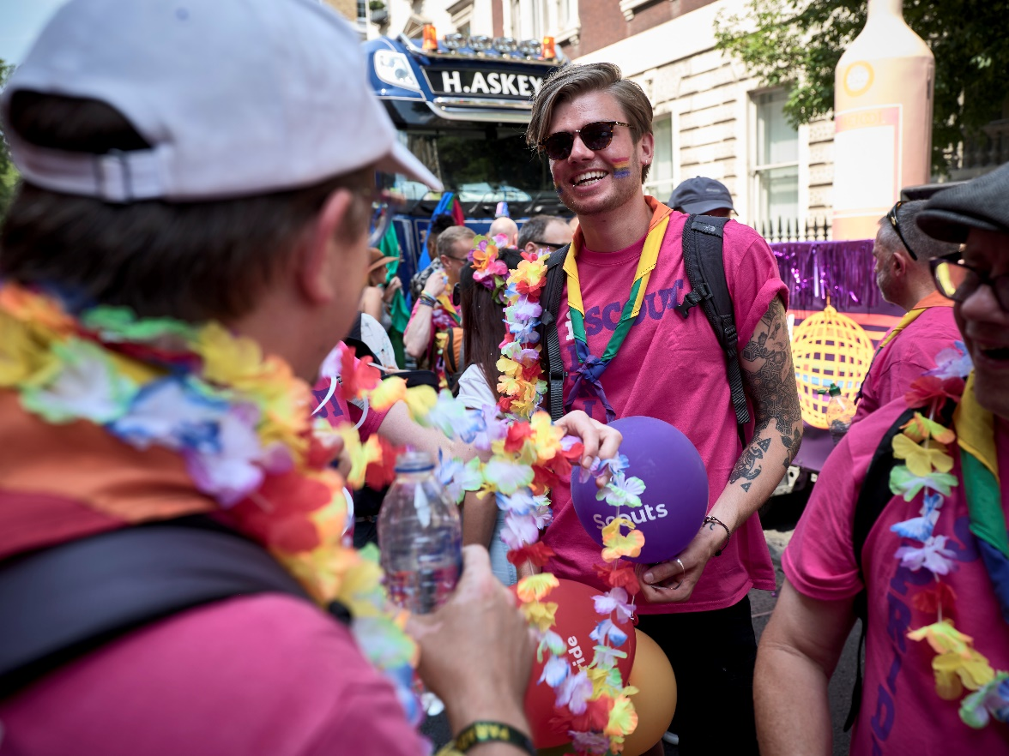
Making Reasonable Adjustments (36)
The Legal Framework
UK Equalities Act 2010
Gender Recognition Act 2004 / 2019
UN Convention on the Rights of Persons with Disabilities
European Convention on Human Rights
UK Scout Association Policies
Notes:
Let participants know that inclusion isn’t only the right thing to do according to our values in Scouts, but we’re also legally required to comply with a number of laws:
UK legal requirements
1. UK Equalities Act 2010
The UK Equalities Act 2010 states that everyone should have access to goods and services and reasonable adjustments should be made to those who require.
2. Gender Recognition Act 2004/2019
The Gender Recognition Act 2004 ensures the protection of the identity of Trans people, and prevention of discrimination.
3. UN Convention on the Rights of Persons with Disabilities
The UN Convention on the Rights of Persons with Disabilities provides protection from harassment and discrimination, highlights the right to fair treatment and the right to equal education opportunities.
4. European Convention on Human Rights
The European Convention on Human Rights provides protection for all minorities and protection for elderly and young people.
5. UK Scout Association Policies
Provides guidance and requirements of UK Scouts.

Slide 9
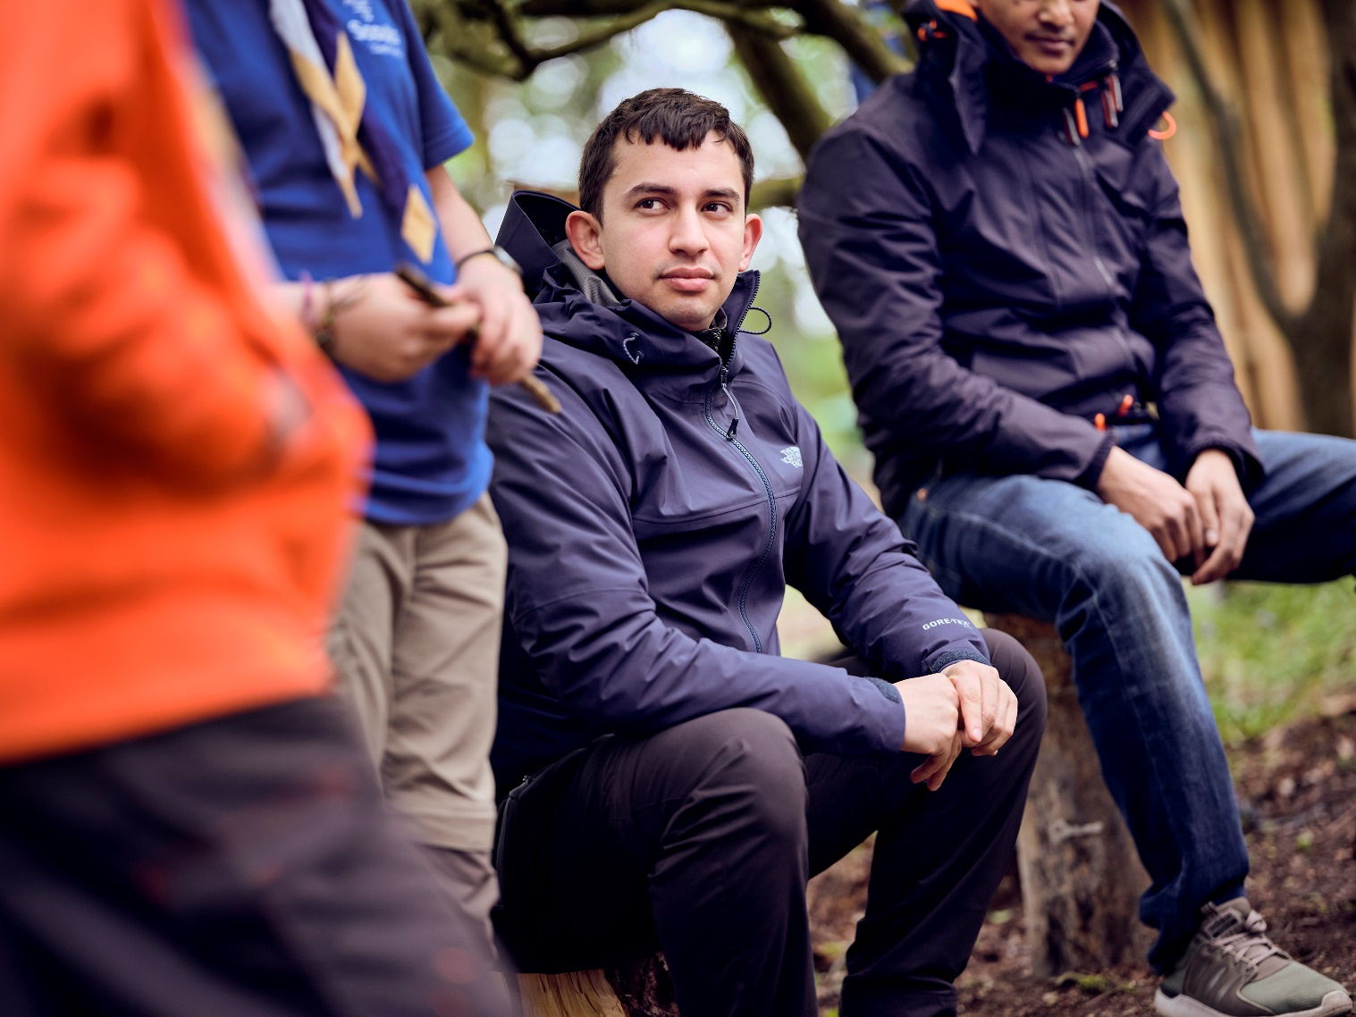
Making Reasonable Adjustments (36)
Some terminology to learn
Disability
Substantial and Long-term
Progressive
Models of disability (how we have conversations)
Social model
Administrative model
Charitable model
Medical model
Notes:
Disability
When discussing adjustments to Scouts, we need to look at what’s meant by disability. If a person is disabled it means they have a physical or mental impairment that has a ‘substantial’ and ‘long-term’ effect on their ability to do daily activities.
What do ‘substantial’ and ‘long-term’ mean?
‘Substantial’ is more than minor or trivial. This may mean it could take much longer than it usually would to complete a daily task such as getting dressed.
‘Long-term’ means 12 months or more. For example, someone could develop a long-term breathing condition as a result of a lung infection. Some disabilities are also progressive.
Progressive conditions
A progressive condition is one that gets worse over time. People with progressive conditions can be classed as disabled.
This can include people with arthritis, some types of hearing or visual impairments, HIV infection, cancer or multiple sclerosis.
Disabilities can be:
Visible/invisible
Variable
Long term or progressive
Temporary
Physical
Mental/cognitive
Behavioural
All disabilities uniquely affect an individual.
It’s important in all cases that leaders accept information about a disability without judgement.
Leaders must never offer, suggest or advise a diagnosis.
The social model of disability
This session focuses on the social model of disability. Model is a word to describe how we have conversations.
The social model of disability proposes that what makes someone disabled is not their medical condition, but the attitudes and structures of society.
When discussing disability, it’s easy to use the wrong models of disability. In Scouts we should always work to the social model of disability. We do this because it’s the correct one described in the Equalities Act 2010 and because it’s the one which protects and empowers the disabled person or disabled young person with the most dignity.
The other models of disability are:
Administrative model – where tests and classifications of people fall into decision making. Forms and interviews would be a method used under this model.
Charitable model - where adjustments, grants, events and decisions are made for a disabled person’s ‘good’ without consulting the disabled person involved.
Medical model – purely focusing on a person’s disabilities as different from ‘normal’ and so adjustments are viewed in a way to make them ‘normal’.
All of these are unlawful approaches and open to legal challenge.
Culture or condition
Many Disabled People with long-term or significant conditions don’t view themselves as disabled, but rather as members of the disabled community. This is important to respect and acknowledge. Remember, under the social model of disability it is society, or in this case Scouts, which is the disabling factor. In the UK the disabled community is vibrant and dynamic with world leading cultural impacts around science, sports, arts, theatre and music.
Terminology
There is no set ‘correct terms’ for talking to, or discussing people’s disabilities other than what the individual has established or requested. If you require a term or correct phrasing, then ask the individual on a case by case instance.

Slide 10
Session 2 – What is a reasonable adjustment?

Slide 11
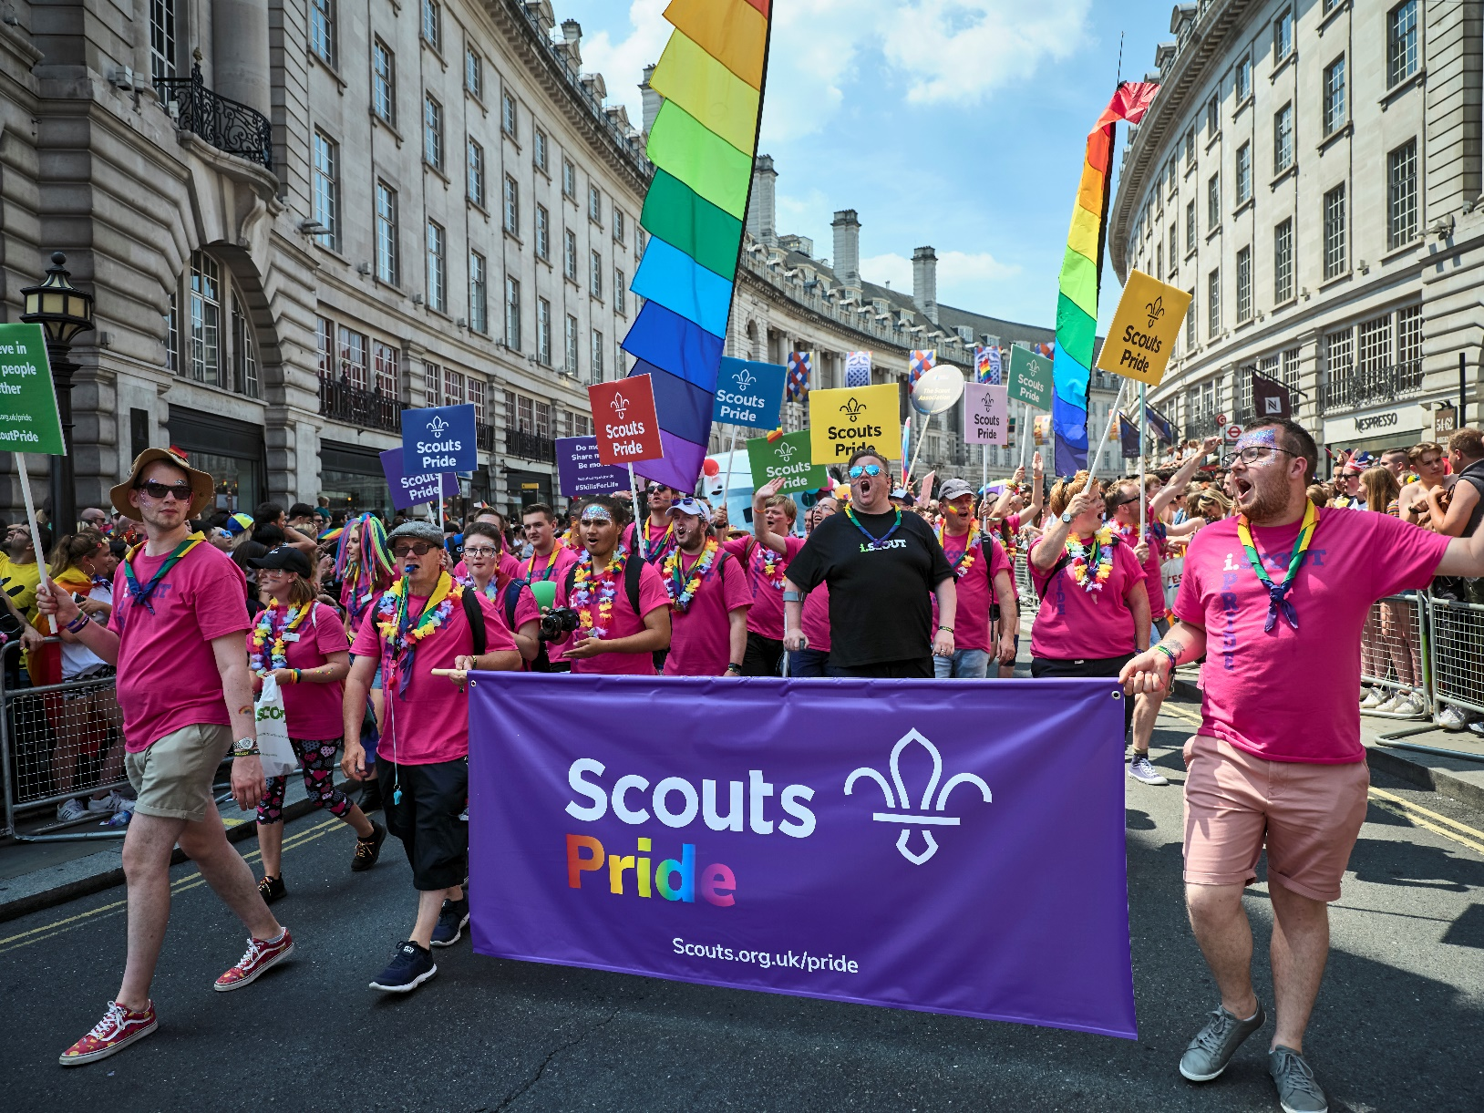
Making Reasonable Adjustments (36)
Making some changes
Notes:
Some kind of activity / discussion where they make changes to an activity to make it accessible – for Zoom I’m thinking that we play some form of word game, but early in the game it becomes apparent that Mel’s audio has stopped working – do we just leave Mel out? What kind of changes could we make to the game to make it accessible for Mel?

Slide 12
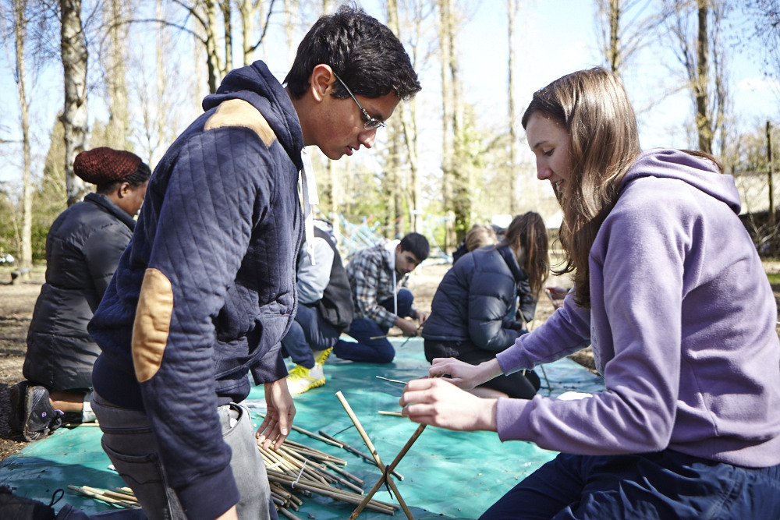
Making Reasonable Adjustments (36)
When is an adjustment needed?
Notes:
When we talk here about adjustments, what we really mean is a process that identifies any factors in Scouts which lead to exclusion, and actively look for ways to remove those barriers to improve access to Scouts. In essence, to deliver Scouting for All.
Making reasonable adjustments is a core part of supporting all young people to fully participate in Scouts to make sure they can develop to their full potential.
Scouts operates in accordance with equality legislation, which in England, Scotland and Wales is the Equality Act 2010. Our Equal Opportunities Policy reflects this legislation. These are known as ‘protected characteristics’, including disability, sexual orientation, race and gender reassignment, amongst others. It’s unlawful to discriminate on the grounds of one or more of the protected characteristics.
As a membership organisation we have a duty to comply with this legislation. Part of this duty includes making ‘reasonable adjustments’ for individuals with a disability.
This duty is outlined in POR. It’s about identifying and removing any barriers to a young person with a disability to fully access Scouts by making changes or adjustments.
Changes can be made to the physical environment – this is about considering the accessibility of the meeting place and taking the needs of all individuals into consideration for any trips/nights away.

Slide 13
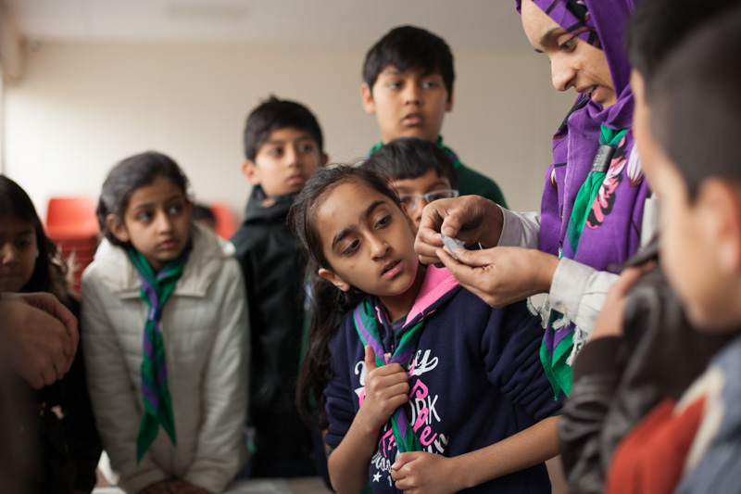
Making Reasonable Adjustments (36)
Badges and Awards?
Notes:
Some young people may require adaptations to access the badge of their choice. Any alterations to the badge or award criteria should be tailored to meet their specific needs. The aim in each case should be to improve access to the badge rather than to reduce the challenge of its requirements. It’s entirely at the discretion of the leadership team how to adapt the criteria – where appropriate, it’s useful to discuss this with the young person themselves, or the parents/carer.
Perhaps consider making the adaptations for the entire section to avoid singling out any one young person. Adaptations should ensure that all participants undertake a similar level of personal challenge.
For the national awards, like the Explorer Belt or QSA you should consult with the relevant commissioner to make sure they understand and are happy with any adaptations. The only exception is that adaptations to DofE must be referred to the awarding body for approval.

Slide 14
Making Reasonable Adjustments (36)
Uniform
Notes:
Uniform shouldn’t be a barrier to taking part in Scouts. Whether, getting a uniform is financially challenging for a family, or for a young person with a sensory hyper-sensitivity who finds the necker uncomfortable, it’s important to be flexible.
Group discussion (10 minutes)
Where an individual is uncomfortable with the necker or shirt collar, identify what the specific challenge is, try to understand why the young person finds this element of the uniform challenging and make adjustments to make sure they’re comfortable. Is a necker really essential? Is a second-hand shirt more comfortable? Is a group sweatshirt easier to wear?

Slide 15
Making Reasonable Adjustments
Moving Between Sections
Notes:
Remember, when a young person joins a section, they’re usually joining a Group and so there’s a need to support their transition from one section to another. This involves sharing information, routines and insights with leaders in the other sections, working together to be flexible around the transition, allowing more time, or supporting them to complete the Moving On Awards, and letting young people stay in a secure group of friends if that seems like the best option.
There’s age range flexibility within Scouts to support all young people to stay in Scouts, and progress through the programme and award scheme.
In some situations, it may help to let young people move outside of the core age ranges. This should always be done with the best interests of the young person in mind (NOT for the convenience of the leaders or parents), and in careful consultation with the parents/carer, leaders, the young person and where appropriate the DC or DESC.
Best practice suggests that where possible a young person should not remain in a section more than six months outside of the core age range. Remember, regardless of any additional needs and disabilities, a young person will still want to access the same activities and social opportunities as their peers.
The only exception is at 18. There is absolutely no flexibility when a young person turns 18, and under no circumstances can an individual remain as a participant in a Beaver, Cub, Scout or Explorer section after their 18th birthday. At 18, all young adults should be moved into Scout Network or adult roles in Scouts.

Slide 16
Making Reasonable Adjustments
Scouts Environment
Notes:
It’s important to evaluate how accessible and inclusive your Scouts space is. This could be identifying that the space needs a physical adaptation such as an access ramp. It may also be that a young person needs to have an area that’s calm. In these instances, you should:
Be positive, calm and caring or provide a time-out
Have a calm/time-out area
Be mindful of sensory stimulation
The above suggestions aren’t the only suggestions

Slide 17
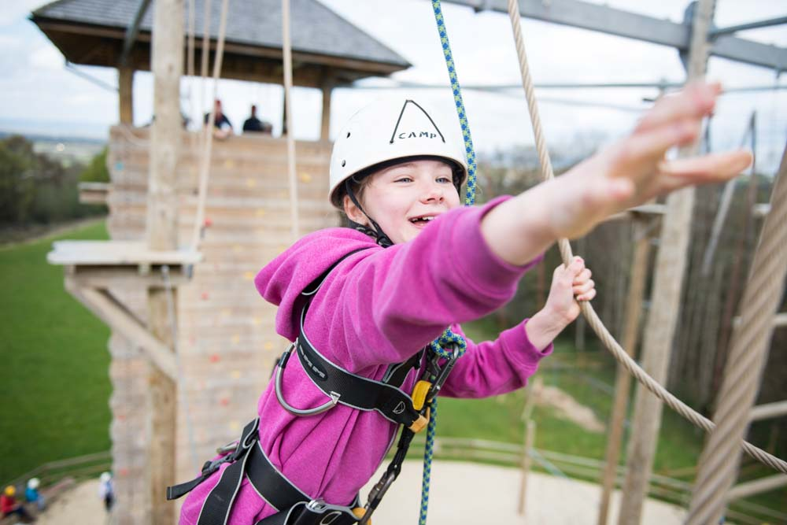
Making Reasonable Adjustments (36)
Temporary Adjustments
Notes:
It’s important to understand some adjustments are temporary, for example a broken limb or other temporary loss of mobility.
These have the same legal duty for an adjustment as a permanent disability.

Slide 18
Making Reasonable Adjustments (36)
Group Task
We’re going to split you into groups. Considering the following areas:
Badges and awards,
Uniform
Nights away
Jamborees
Kayaking event
What adjustments do you think might be required for the following?
A Beaver who uses a wheelchair
An Explorer with autism
A leader who’s deaf
A Cub with low-dexterity
A Scout from an economically disadvantaged background
Notes:
The Scout Programme is designed to be flexible, so badge/award requirements can be tailored to individual needs. It also makes sure there’s flexibility in age ranges for sections.
The flexibility in Scouts means that all young people, regardless of their abilities, can enjoy and achieve.
As Managers and Section Leaders, these are areas which you’ll most commonly make reasonable adjustments to (in fact, you’re probably doing so already).

Slide 19
Session 3 – Making Adjustments
Notes:
5 mins (1400 - 1405

Slide 20
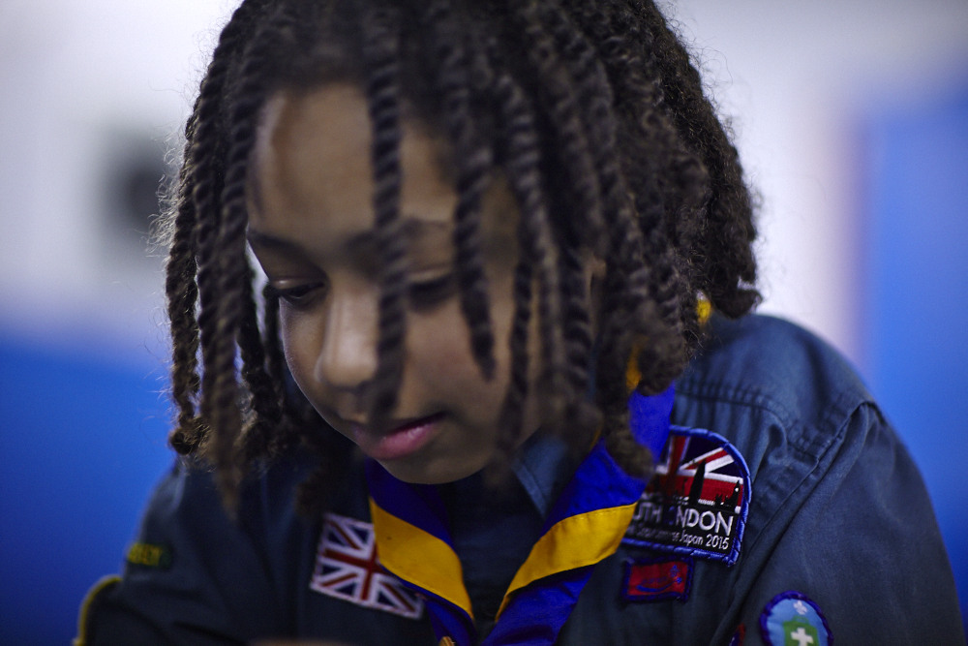
Making Reasonable Adjustments (36)
Parent Conversations
Parent Conversation Framework
Notes:
Share these tips with participants to help them make successful reasonable adjustments:
Be Positive
Remember, conversation is not a contract
Frequently review the adjustment to see if it’s working
Keep up all communication and stay engaged
Allow parents/carers to be a part of the decision making
Scout Groups should never assume any unreasonable costs without funding
Be realistic

Slide 21
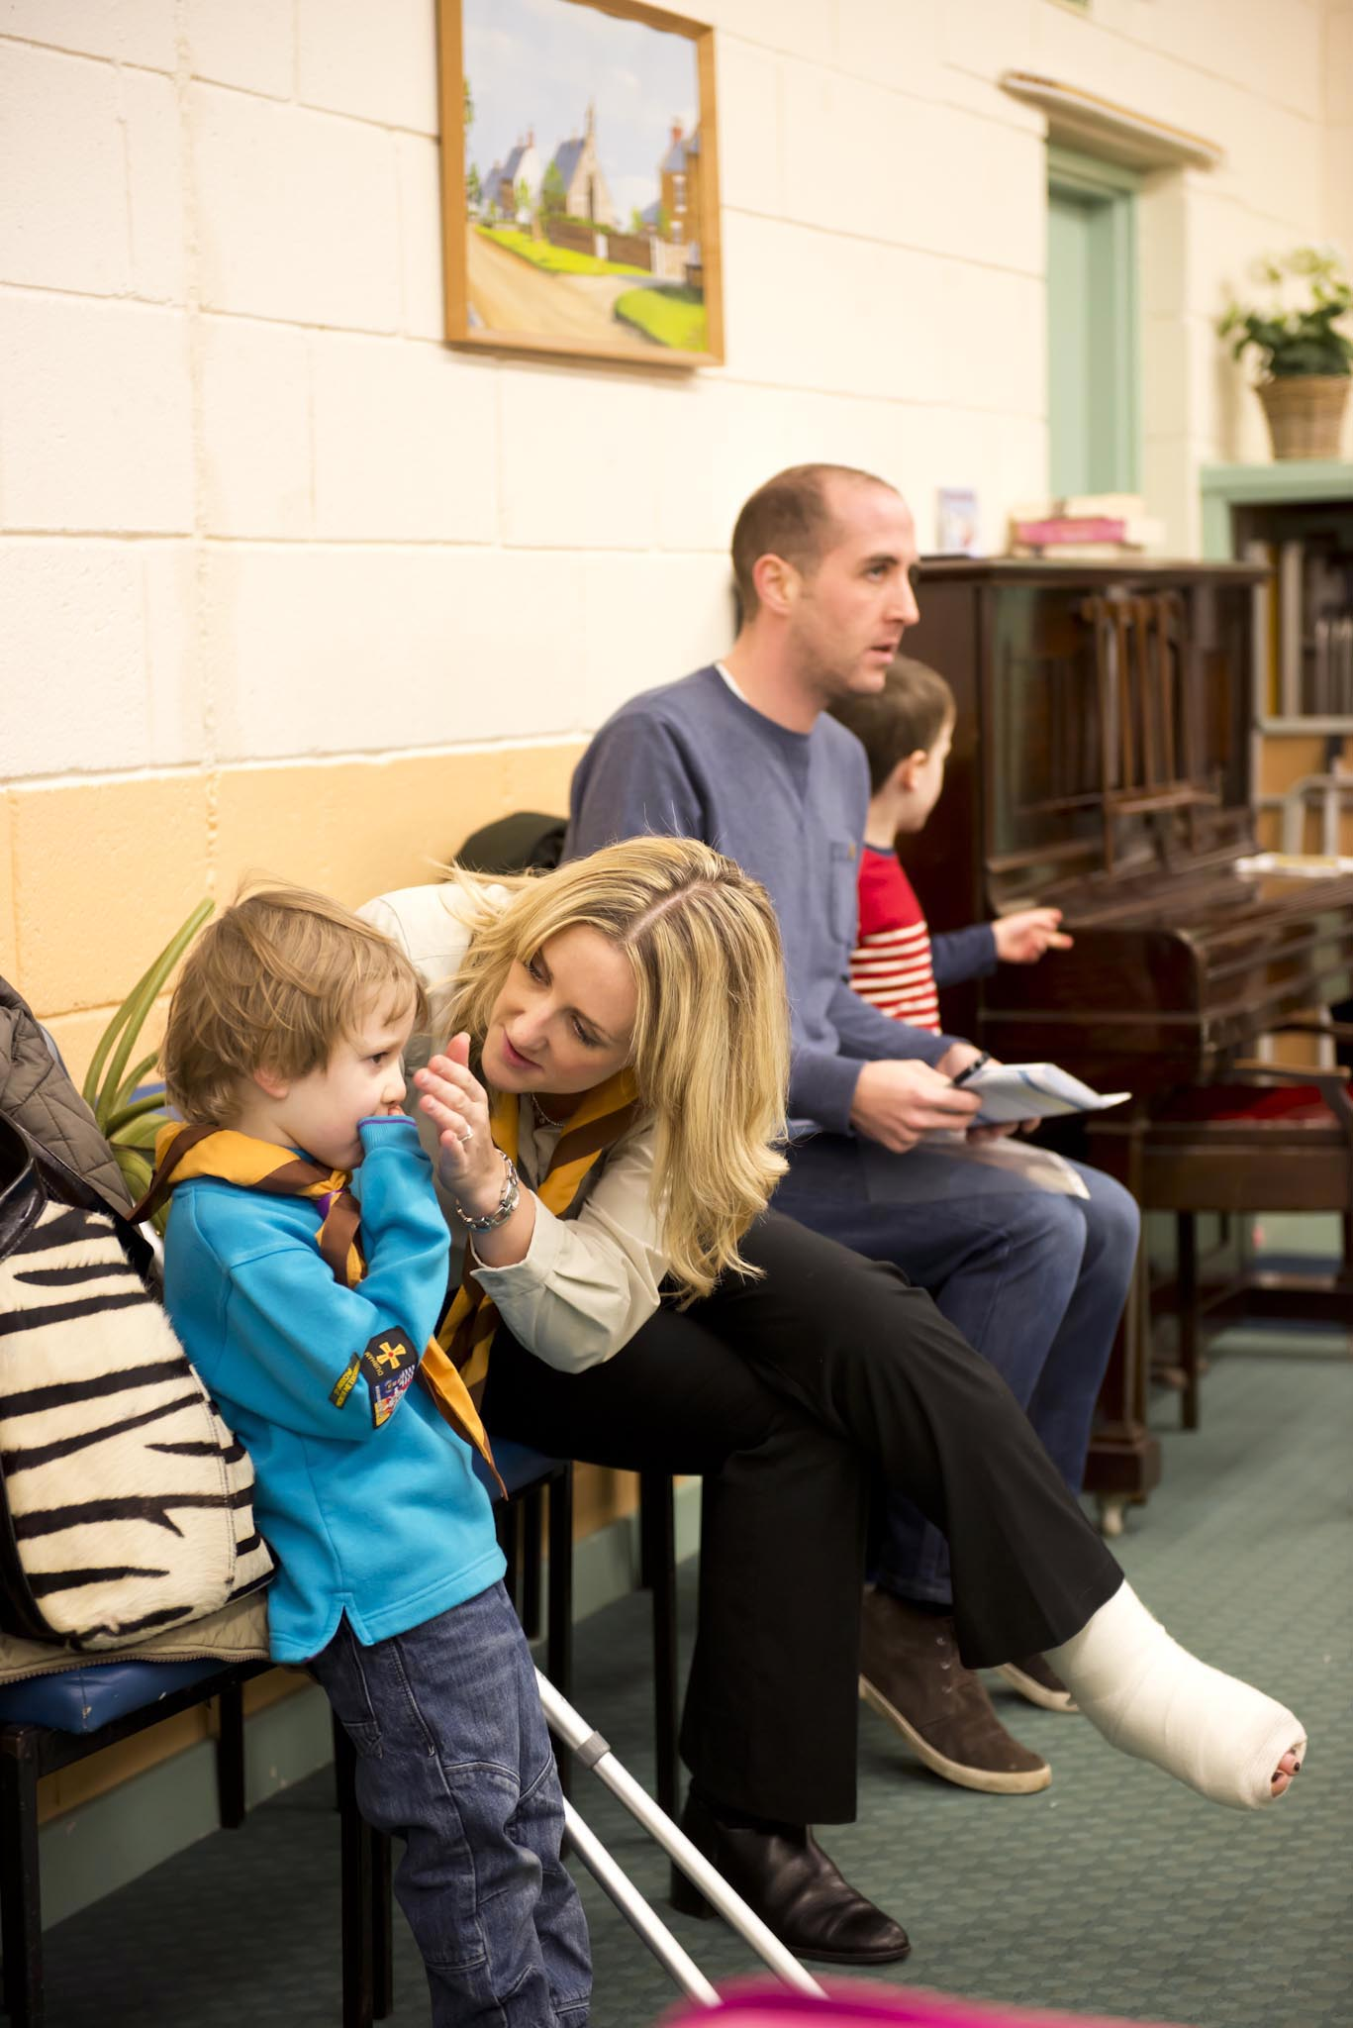
Making Reasonable Adjustments (36)
Starting a Conversation
Notes:
We know that Scouts works well when we’re part of a team and work together. It’s vital to foster effective team working relationships to truly offer inclusive Scouts. Parents/carers have a wealth of ‘expert’ information about their young person, so they’re a key source of information.
The best approach is to build a positive relationship with the parents/carer, in which leaders can explain the need to understand the detail of a young person/s additional needs. Important topics to cover include their likes/dislikes, management strategies, triggers, what happens at home and at school.
The value of a conversation is that there’s the opportunity to stress that Scouts is delivered by volunteers, not paid professionals or experts, but that leaders are willing to make reasonable adjustments to support participation. It’s important to make sure parents/carers have a realistic expectation of Scouts.
Going through the programme in detail is a good way to build the relationship with parent/carers. Regular communication and reflections on progress also helps to maintain the relationship.
At the same time, it’s essential to get to know the young person as an individual. Involving older young people in the conversation may also be appropriate

Slide 22
Making Reasonable Adjustments (36)
1:1 Support Workers
Notes:
If one-to-one support is needed and the group are able and confident to provide this, that’s fantastic, but remember that Scouts is not a statutory provision, like the education system, so there’s no legal requirement to provide one-tone support, if the capacity or skills don’t exist.
It’s important to know this in your role, to help manage the expectations of parents and other leaders. One-to-one supporters may be required where a young person has personal care needs, for example. This could require an adult acting outside of the Yellow Card, so this care should be provided by a family member or professional.
In Scouts, a one-to-one supporter attends exclusively to support the individual young person, so should not be counted within the adult ratio. This person is not a helper and should be over the age of 18. Young Leaders, or siblings of a young person who are also within the Group should not be fulfilling this role.
All one-to-one supporters must be appropriately vetted. Where a young person is accompanied by a professional carer it’s advisable to contact the Vetting Team at HQ to discuss your situation so they can advise. Most often a oneto-one supporter is a parent or carer.
The provision of an external/ professional carer is the responsibly of the family; the Scout Group should not take on the financial responsibility of employing a carer

Slide 23
Making Reasonable Adjustments (36)
Discussion Activity
Discuss ways in which an adjustment could be made for the following scenario using the parent/carer framework agreement:
A Cub is attending a camp. Two days before the campe. The one-t—one support worker who assists with their personal complex meical needs informs a Section Leader that they can’t make the camp. The Section Leader then contacts the DC to discuss options.
What would be the best course of action to make sure that the young person isn’t excluded from the event?
Notes:
The correct answer is to first discuss the situation with the parents/carers to explain the issue. It can sometimes be useful for such scenarios to be tested against an adjustment in the planning stage.
Scout leaders should never assume any responsibility for administering complex medical treatment unless appropriately and professionally trained to do so and with prior agreement from their line manager.

Slide 24
Making Reasonable Adjustments (36)
Autism
.
Notes:
Let everyone know that this is currently a prevalent topic in Scouts. The purpose of this topic is to give a basic overview of autism and how to best support autistic individuals.
Autism is a lifelong condition affecting how someone communicates with and relates to other people and to the world around them.
‘It’s as if someone is playing some complicated games and I am the only one who hasn’t been told the rules’
National Autistic Society
Encourage participants to imagine seeing the world this way:
Seeing the world in pictures with an altered sense of reality
Being unable to read emotions or feelings
Taking everything that’s said to you literally
Senses more acutely than everyone else
Unable to cope with ANY change of plans
Planning and adjusting Scouts for autistic young people helps to make sure they have a truly meaningful experience in Scouts. The following ideas can enable inclusive Scouts:
Provide structure and routine
Explain what’s happening now and next
Prepare for changes or new situations
Clear rules and expectations for all
Be prepared and plan ahead
Visual stories are resources that can support young people with learning and/or speech and language difficulties. They portray various scenarios within Scouts in a way that’s visually accessible. Leaders can either show the visual stories directly to the young person or use the signs shown in the stories to communicate with the young person.

Slide 25
Close
Notes:
5 mins (1400 - 1405

Slide 26
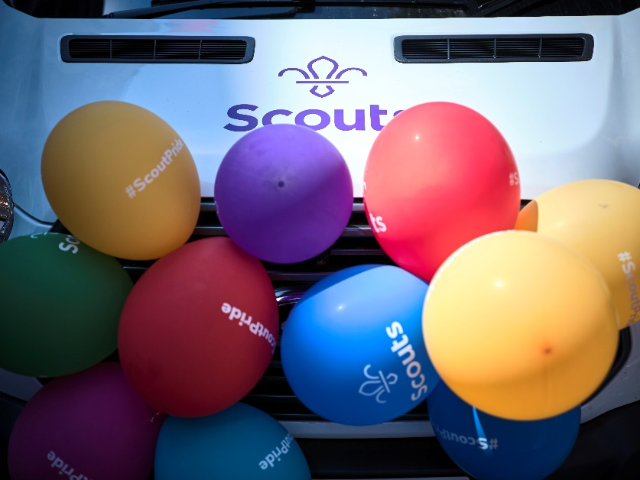
Making Reasonable Adjustments (36)
Your Scouting
From the activities, learning and discussions throughout this session, what will you take away back to your Group / section and apply to your Scouting to make it more inclusive?

Slide 27
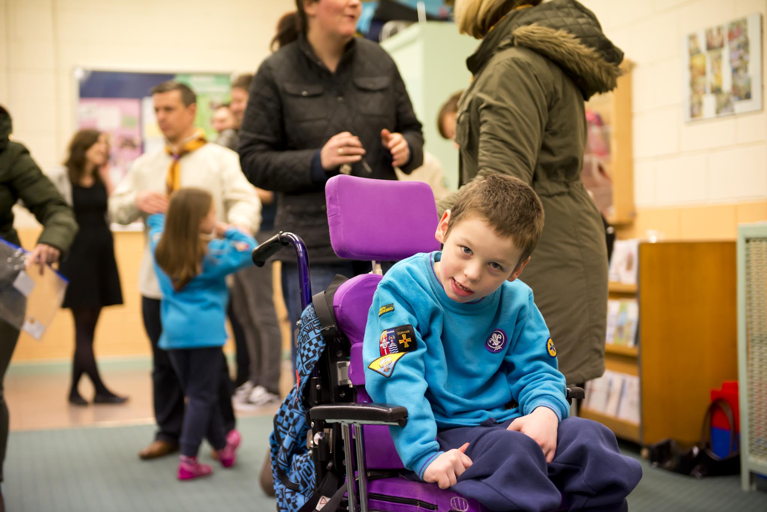
Making Reasonable Adjustments (36)
Questions?

Slide 28
Making Reasonable Adjustments (36)
Further Support
Diversity and Inclusion
Use of the visual stories (Scouting for All)
Specialist training from the Advisors team
Inclusion themed training events
Information Centre
NAS Training and Autism pages

Slide 29
Making Reasonable Adjustments (36)
How to validate this training.
COMPLETE BOTH OF THE FOLLOWING
Show evidence of how you are making Scouting accessible to those with additional needs.
Increase awareness of additional needs by running an activity or event for either young people or adults.

Slide 30
Thank you

