Slide 1
Module 37 – Advising on Adult Appointments

Slide 2
Section 1
Purpose and Values
The Appointments Process
The Appointments Advisory Committee
Responsibilities of the Appointments Advisory Committee
Section 2
Appointment Panel Meetings

Slide 3
Section 1

Slide 4
The Purpose of Scouting
Scouting exists to actively engage and support young people in their personal development, empowering them to make a positive contribution to society.

Slide 5
The Values of Scouting
Integrity - We act with integrity; we are honest, trustworthy and loyal.
Respect - We have self-respect and respect for others.
Care - We support others and take care of the world in which we live.
Belief - We explore our faiths, beliefs and attitudes.
Co-operation - We make a positive difference; we co-operate with others and make friends.

Slide 6
Terminology
Appointments Advisory Committee | The committee appointed by the relevant Executive Committee to assist with the process of appointing adults in Scouting.
Appointment Panel | A panel of three persons drawn from the Appointments Advisory Committee which undertakes a meeting with an applicant for a role in Scouting. The panel’s purpose is to ensure the applicant is aware of and accepts the values and policies of The Scouts and they understand the requirements of their role and is able and willing to carry it out.

Slide 7
The Appointments Process

Slide 8
The Appointments Process - Purpose
The purpose of the appointment process is to ensure that all those adults that the Movement accepts as volunteers:
Are appropriate persons to volunteer with The Scouts
Are appropriate for the roles they are undertaking
Fully accept the responsibilities of the roles and, where appropriate, the responsibilities of membership of The Scouts

Slide 9
The Appointments Process - Principals
The appointment process must be run so that:
the applicant feels welcomed, valued and not threatened by the appointment
the applicant is kept informed of progress through the appointment process
the Association has robust assurance of appointing only appropriate people
the applicant takes a role that is appropriate to their skills, knowledge and attitude

Slide 10
The Appointments Process - Stages
Application: a line manager agrees to support an adult applying for an appointment and agrees a role description for that appointment

Slide 11
The Appointments Process - Stages
Approval: independent checking concludes that the applicant is suitable for an appointment and includes agreement from the relevant Commissioner or body, successful outcome of the Personal Enquiry and, where appropriate, taking up two references.

Slide 12
The Appointments Process - Stages
Appointment: the relevant Commissioner or body makes the appointment.

Slide 13
The Appointments Process - Stages
Induction: the line manager ensures that the adult receives a high quality induction (this stage starts from the application process and runs for some time after the appointment is made).

Slide 14
The Appointments Process – Core Elements
Personal Enquiry
(CE & DBS checks)
References
(if required)
Appointment Panel
(values; fit to role)
(if required)
Commissioner (or Committee or Council) approval
Getting Started (key initial training)
None is more important than the others - these 5 steps should be ‘run’ in parallel.

Slide 15
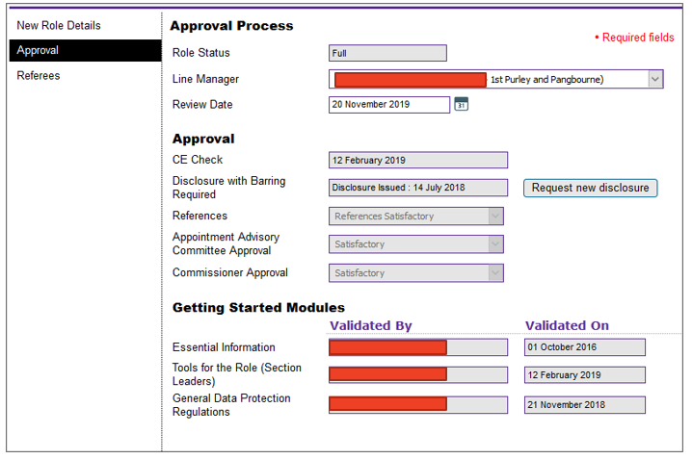
The Appointments Process – Compass

Slide 16
The Appointment Processes
Process 1
Roles that are appointed using the Appointment Process managed by the relevant Appointments Advisory Committee
e.g. a Section Leader for Beavers

Slide 17
The Appointment Processes
This processes does not require approval by an Appointments Advisory Committee
Process 2
Roles that are appointed by the relevant Scout Council at their Annual General Meeting. When the relevant electoral body has at its AGM elected a member of the Executive Committee or agreed the nomination of a member to the Executive Committee.
e.g. the election of a member to the County Executive Committee

Slide 18
The Appointment Processes
This processes does not require approval by an Appointments Advisory Committee
Process 3
Roles that are appointed by the relevant Executive Committee. When the relevant Executive Committee has appointed a role within its authority
e.g. the nomination of a member to the District Executive Committee

Slide 19
The Appointment Processes
There are a number of roles in Scouting for which the adult does not meet with an Appointment Panel, nor are references required.
These roles include:
Nominated/elected trustees
Co-opted trustees
Presidents
Advisers and Administrators

Slide 20
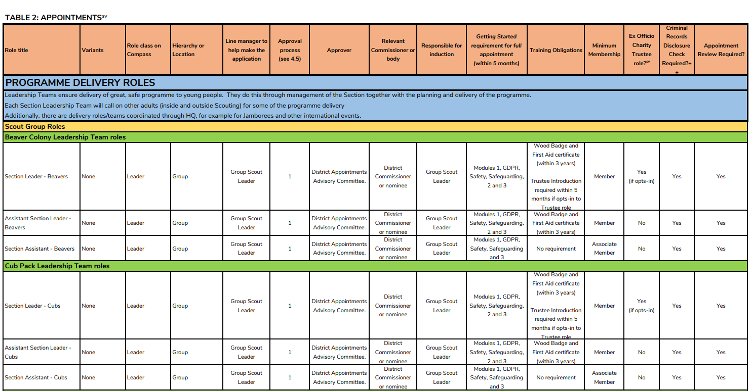
The Appointment Process – Table 2

Slide 21
The Appointment Process - Roles
Line manager
The line manager recommends the applicant for the appointment.
Approver The appointment is approved by the Appointments Advisory Committee, the relevant Executive Committee or the relevant Scout Council according to the appointment being made.
Relevant Commissioner/Body The relevant Commissioner, the relevant Executive Committee or the relevant electoral body with the responsibility for making the appointment.

Slide 22
The Appointments Advisory Committee

Slide 23
Appointments Advisory Committee - Roles
The Appointments Advisory Committee (AAC) is a mandatory sub-committee of the relevant Executive Committee
The AAC is appointed by the relevant Executive Committee
The AAC is responsible to the relevant Executive Committee
The AAC members are: Appointments Chair, Appointments Secretary and a pool of committee members

Slide 24
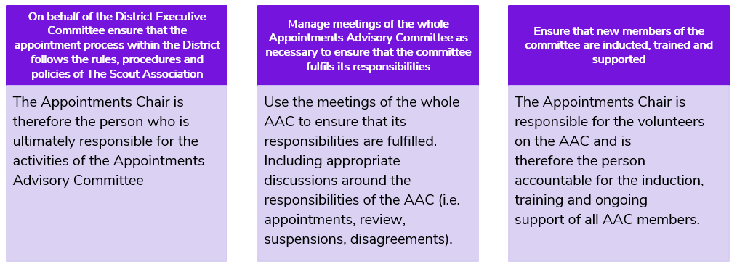
Appointments Chair

Slide 25
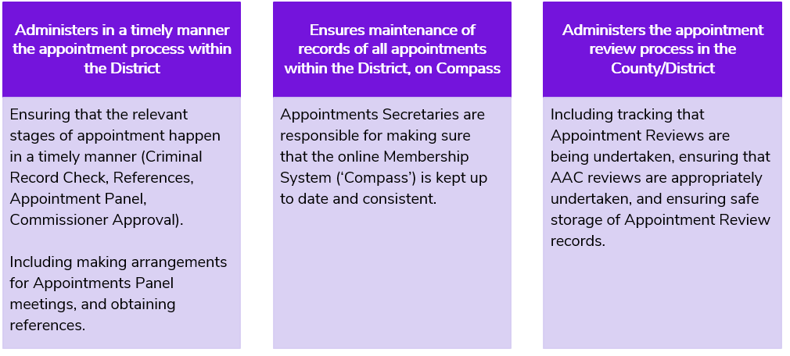
Appointments Secretary

Slide 26
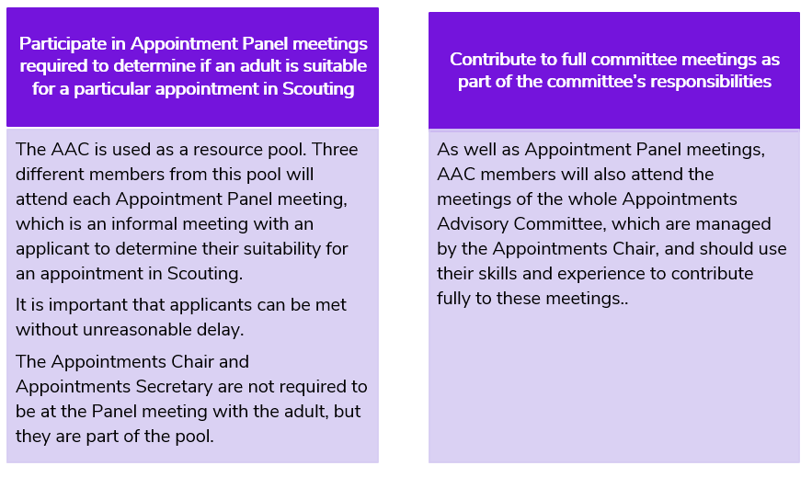
AAC Members

Slide 27
Responsibilities of the Appointments Advisory Committee

Slide 28
Role of the AAC
The AAC is responsible for:
Appointment Panels
Appointment Reviews
Suspensions
Complaints
Cancellations

Slide 29
Appointments Panel – Conversation Framework
Welcome the new volunteer to Scouting
Introduce the new volunteer to their role
Understand what the new volunteer would like to get from Scouting
Introduce the Values, Promise and Policies of Scouting
Discuss the next steps in the appointments process for the new volunteer
To support with the delivery of the Appointment Panel conversations you can use the Appointment Meeting Conversation Guide.
Try to ensure that your AAC has a diverse range of members so that you can best meet the needs of any volunteer at an Appointment Panel.

Slide 30
Appointment Reviews
What is the Appointments Advisory Committee’s role?
Ensuring that the Appointment Review process is working well across the District or County.
The AAC is only responsible for ensuring that appointment review reminders are sent to line managers and reviewing the appointment review forms once they have been completed.

Slide 31
Complaints
What is the role of the Appointments Advisory Committee in resolving disagreements between adults?
Support the manager if necessary by considering the findings of an investigation.
The Appointments Advisory Committee does not investigate the dispute.

Slide 32
Suspensions
Who has the right to suspend an appointment?
Only the relevant Commissioner has the authority to suspend someone, with the approval of their line manager.
What is the role of the Appointments Advisory Committee in dealing with suspensions?
The committee supports the Commissioner in dealing with the consequences of this process, specifically supporting and advising on whether to lift the suspension and reinstate the person.
What is the Appointments Advisory Committee’s role?
To help ease the decision-making load on the Commissioner, and therefore reduce the likelihood of them being accused of personal prejudice against the adult.

Slide 33
Cancellation
What is the Appointments Advisory Committee’s role in cancelling appointments?
To support and advise the relevant Commissioner if required;
To ensure a Cancellation/Suspension is recorded on Compass, with the appropriate reason for cancellation recorded.

Slide 34
In summary…

Slide 35
In Summary…
The Appointments Advisory Committee members must act sensitively and in confidence.
The Appointments Advisory Committee members will be involved in dealing with and advising on sensitive issues.
It is an essential part of the role that the Appointments Advisory Committee must remain focused on facts and not be influenced by personal bias.

Slide 36
Section 2

Slide 37
In Summary…
Appointment Meeting Conversation Guide.
Notes:
Matt

Slide 38
Appointment Panel Meetings

Slide 39
What is the purpose of Appointments Panels?
Make new members of The Scouts feel welcomed
Ensure that new members are aware and accept the values, policies and promise of The Scouts
Support new members to understand the requirements of their role

Slide 40
Planning the Conversation
Prerequisites to attend the Appointments Panel
Documents to provide
Venues
Makeup of Appointments Panels
Preparations

Slide 41
The structure of the Appointments Panel conversation
Welcome the new volunteer to Scouting
Introduce the new volunteer to their role
Understand what the new volunteer would like to get from Scouting
Introduce the Values, Promise and Policies of Scouting
Discuss the next steps in the appointments process for the new volunteer

Slide 42
During the Conversation
Ensure that the new volunteer feels like it is an informal and welcoming conversation and not an interview.
Be positive but realistic. Help them understand what to expect from and what they can get from The Scouts.
Take the lead from the new volunteer’s responses and do not feel the need to ask questions if you feel they have already answered them.
Remember that each new volunteer will be different, so avoid making any assumptions.

Slide 43
Welcome the New Volunteer to The Scouts
Thank you
Introductory questions
Introduce the District/Area/County/Region
Explain the purpose of the conversation

Slide 44
Introduce the new volunteer to their role
Questions
Role descriptions
Agreeing the role

Slide 45
Understand what the new volunteer would like to get from the Scouts
Questions
What does a new volunteer want from volunteering with The Scouts?
Training

Slide 46
Introduce the Values, Promise and Policies of The Scouts
Questions
Values, Promise and Policies
Young Person First (Yellow Card)
Being aware and accepting the Values, Promise and Policies

Slide 47
Discuss the next steps in the appointments process for the new volunteer
Questions
What does this look like in your Districts/Areas/Counties/Regions?
Contacts

Slide 48
Closing the Conversation
Questions
Is the volunteer leaving happy?
Thank You

Slide 49
After the Conversation
Informing the Appointments Secretary
Informing the Volunteer Manager

Slide 50
In summary…

Slide 51
In Summary…
The Appointments Advisory Committee members must act sensitively and in confidence.
The Appointments Advisory Committee members will be involved in dealing with and advising on sensitive issues.
It is an essential part of the role that the Appointments Advisory Committee must remain focused on facts and not be influenced by personal bias.

