Slide 1
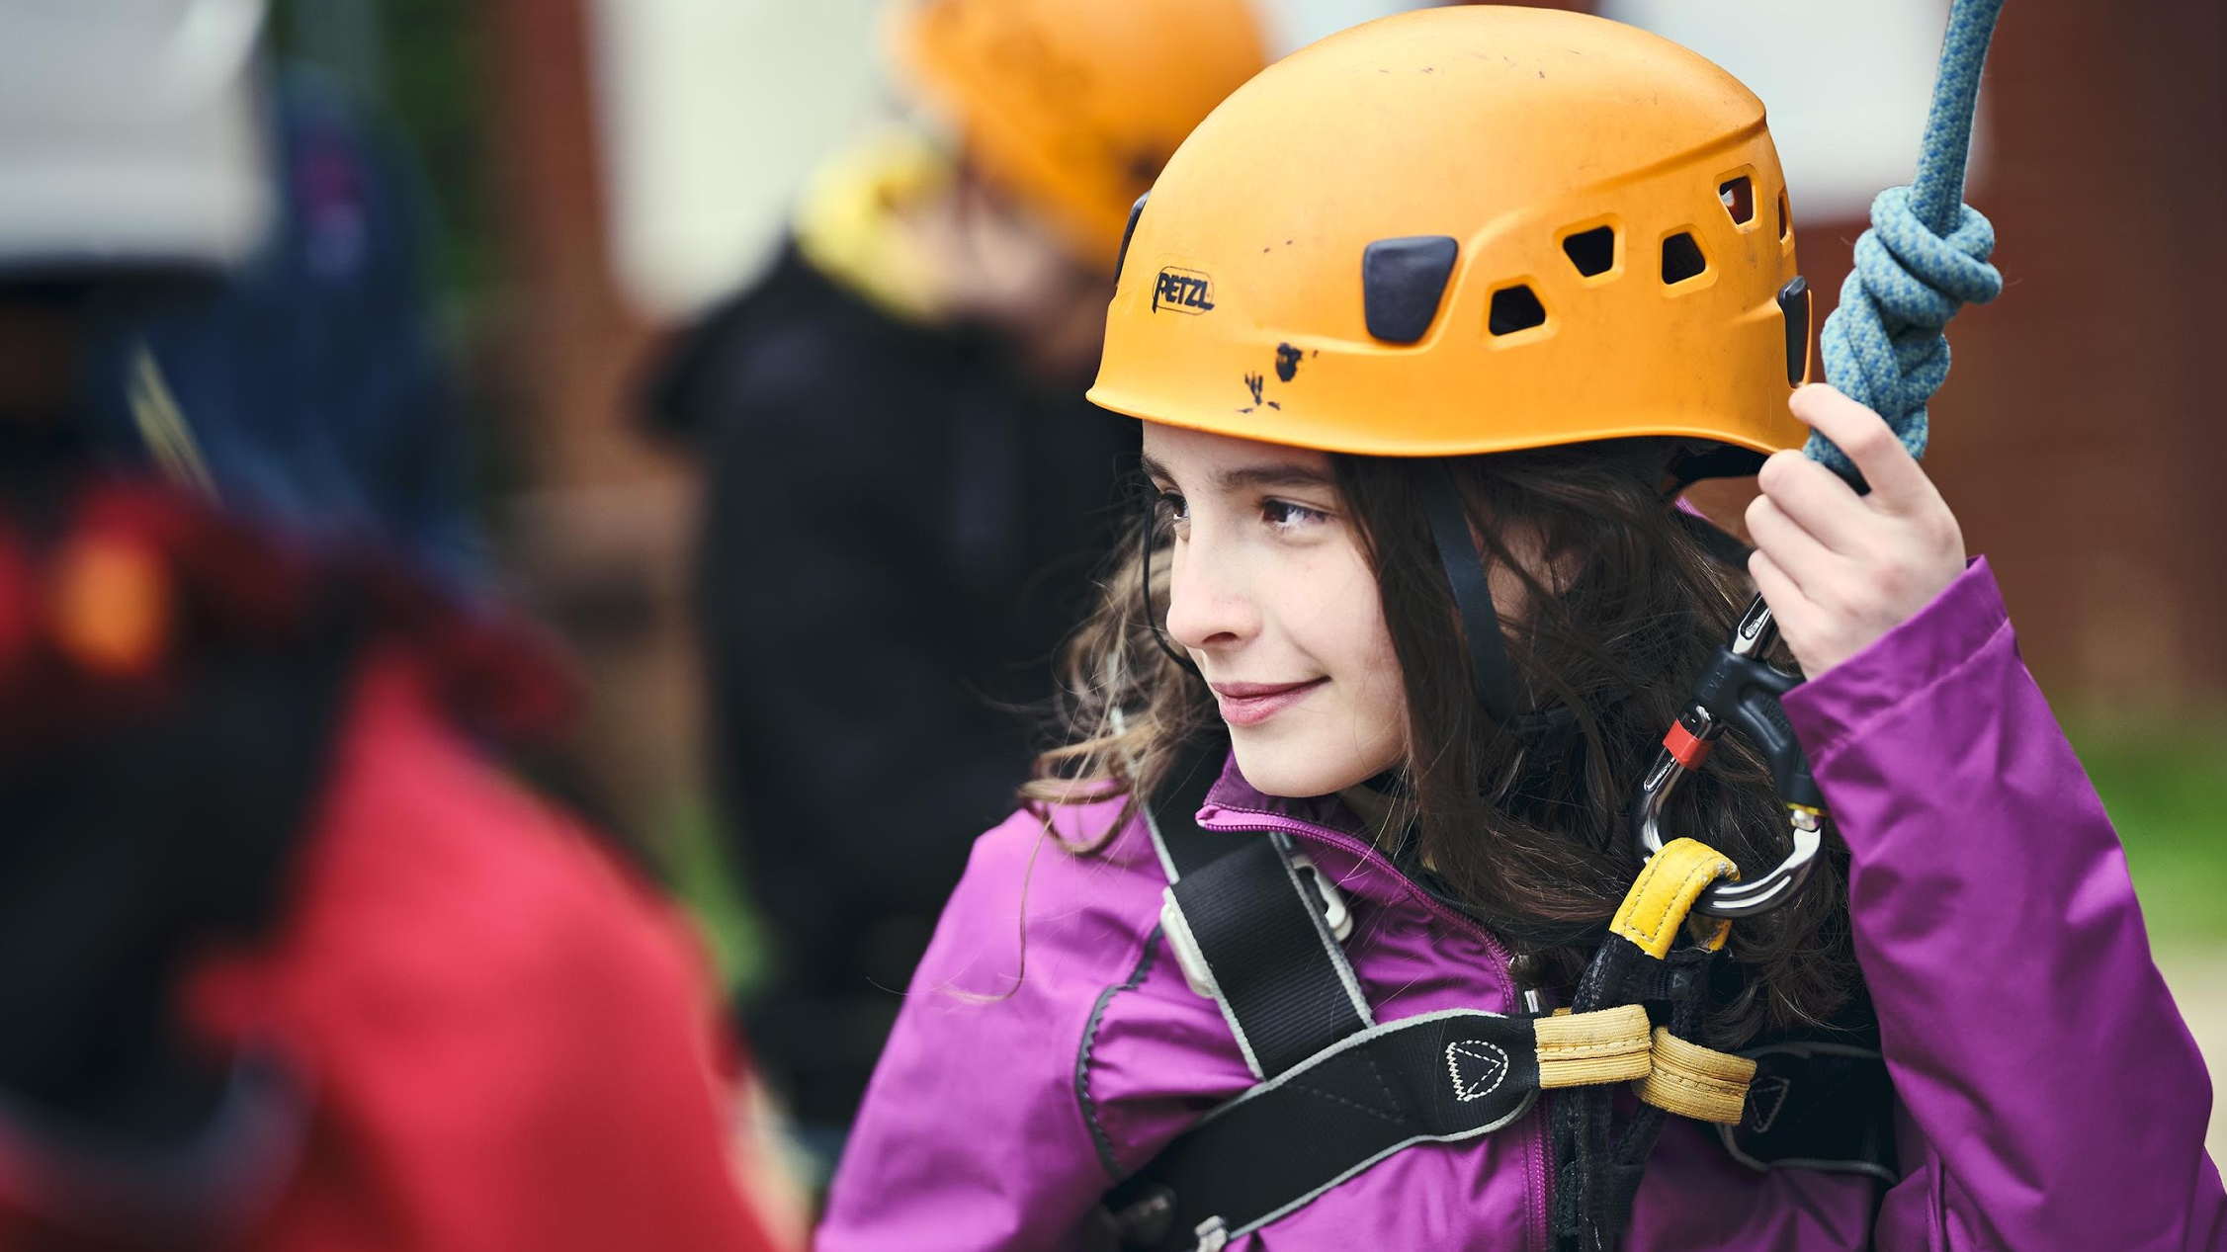

Module 10A/K
First Response
August 2024
Notes:
Prior to course
All participants to complete e-learning. You should ask students to supply a copy of certificate or contact Hampshire Scouts to be able to check e-learning system first.aid@hampshirescouts.org.uk.
https://hampshire-scouts.thinkific.com/courses/firstresponse
Set up
PowerPoint - ensure you have the latest version and at least two tutors have access in case of technical issues.
Polls - Create a poll on Teams or Zoom with the following options: (Quiz) Multiple Choice - A, B or C and (Walking debate) True, Partly True, Middle (could be true or false), Partly False & False. You could also use Menti or other software if you prefer.
Breakout rooms - ensure you are familiar with the use of Breakout rooms in teams and zoom as this is used in the activities.

Slide 2
Webinar – what you need to know
Your tutors for today are …
Please pop any questions you have in the chat and we will try and answer them
We will be using on screen polls for a quiz
Sometimes you will go into Breakout rooms, if there is no facilitator and you need help – please us the ‘ask for help’ button.
This sessions lasts around 2 hours 45 mins including a short break
Notes:
0:00 (2 mins)
Introduce tutors
Run through any things people need to know about the webinar
You can add your own code of conduct e.g. around staying on mute, cameras on in break out rooms if you like.

Slide 3
Aims:
To refresh the knowledge from the First Response e-learning
To apply the principles of first aid to Scouting situations
To prepare for the practical validation session
Notes:
0:02 (1 min)
Run through aims of the course, as described

Slide 4
Module 10A & B
Completion of first response
Completion e-learning plus this Zoom session = module 10A First Aid Theory which can be added to the membership system and is valid for 3 years.
Module 10B – First Aid Practical is a short 15 minute session which is valid for 3 years. You need to keep both modules in date.
This includes: Know and demonstrate (or instruct a trainer) your skill in performing
  Approach and assessment of scene/incident
  CPR for an adult
  CPR for a child
Notes:
0:03 (2 mins)
Run through module 10A/B and add any local information on where to access local training dates

Slide 5

Quiz – refresher from the e-learning
Notes:
00:05
to
00:50
45 mins
Quiz
Go through the 20 questions, use polling function where there are A, B & C options and chat function for open questions.
Go through answers as per PowerPoint slides - see notes for further guidance.
PowerPoint slides 5 - 40
Polling function on Zoom https://support.zoom.us/hc/en-us/articles/213756303-Polling-for-meetings
Polling function on Teams https://support.microsoft.com/en-us/office/poll-attendees-during-a-teams-meeting-9923b7d4-ea97-4aa2-b8b8-b45fefe7d454
Or using Menti (second device needed)
Poll to include A, B & C
Some questions use the chat for answers

Slide 6
Question 1
What does DR ABC stand for?
A) Danger Response Airway Breathing Circulation/CPR
B) Danger Response Airway Breathing Call 999
C) Don’t Remember Always Be Cool

Slide 7
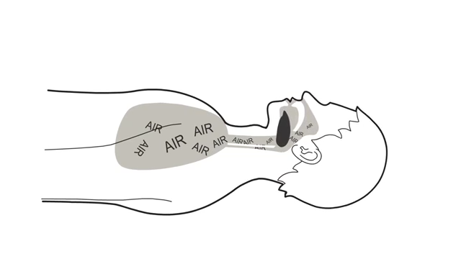
Question 1
What does DR ABC stand for?
A) Danger Response Airway Breathing Circulation/CPR
B) Danger Response Airway Breathing Call 999
C) Don’t Remember Always Be Cool
Notes:
Run through DRABC and the animation shows opening the airway and is animated

Slide 8
Question 2
What is the treatment for an unresponsive, breathing casualty?
A) Call 999, place them on their side in the recovery position
B) Place them in the recovery position, call 999
C) Call 999 then start CPR

Slide 9
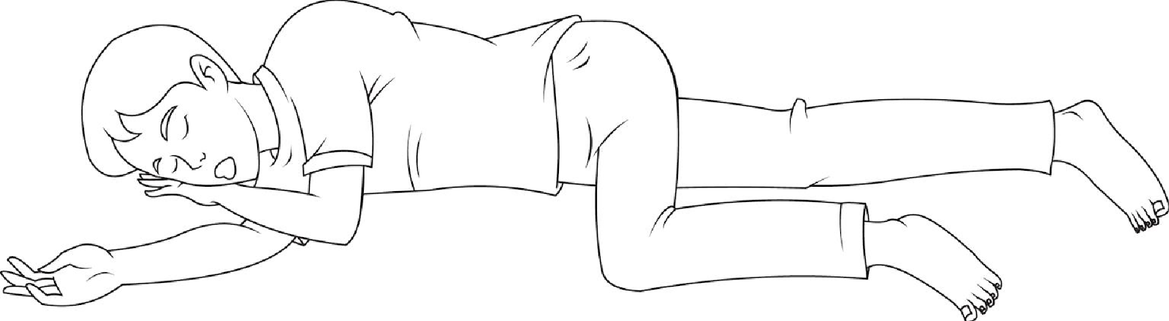
Question 2
What is the treatment for an unresponsive, breathing casualty?
A) Call 999, place them on their side in the recovery position
B) Place them in the recovery position, call 999
C) Call 999 then start CPR
Notes:
Remind people about the purpose of recovery position – airway open, vomit can drain

Slide 10
Question 3
What is the treatment for an unresponsive, non-breathing adult casualty?
A) Call 999, place them on their side in the recovery position
B) Start CPR for a few minutes then call 999
C) Call 999 then start CPR (30 compressions : 2 breaths)

Slide 11
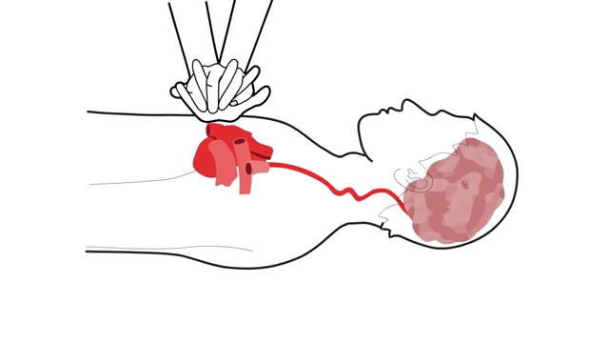
Question 3
What is the treatment for an unresponsive, non-breathing adult casualty?
A) Call 999, place them on their side in the recovery position
B) Start CPR for a few minutes then call 999
C) Call 999 then start CPR (30 compressions : 2 breaths)
What would you do if they were making gasping / wheezing breathing sounds?
Notes:
Video to show effect of CPR
Agonal breathing – wheezing / gasping sounds – start CPR

Slide 12
Question 4
Which of the following would be different for a child aged 1 to 18*?
A) Give 5 initial rescue breaths
B) Use one hand to do the compressions (depending on size)
C) Both A & B
* Updated 2021 https://www.resus.org.uk/library/2021-resuscitation-guidelines/paediatric-basic-life-support-guidelines

Slide 13
Question 4
Which of the following would be different for a child aged 1 to 18?
A) Give 5 initial rescue breaths
B) Use one hand to do the compressions (depending on size)
C) Both A & B
Press down 1/3 of the depth of the chest at a rate of 100-120 times per minute
Notes:
Remind people about key differences between adult and child CPR

Slide 14
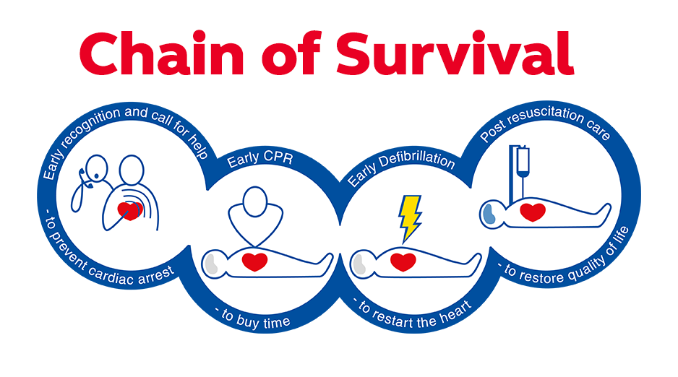
Dial 999 as soon as possible
Send for an AED if available
Start CPR
Follow advice given by the emergency operator
Notes:
Remind people about Chain of Survival and importance of getting an AED

Slide 15
Question 5
What would you do first if you suspect someone is choking?
A) Give up to 5 back blows
B) Give up to 5 abdominal thrusts
C) Ask them if they can cough

Slide 16
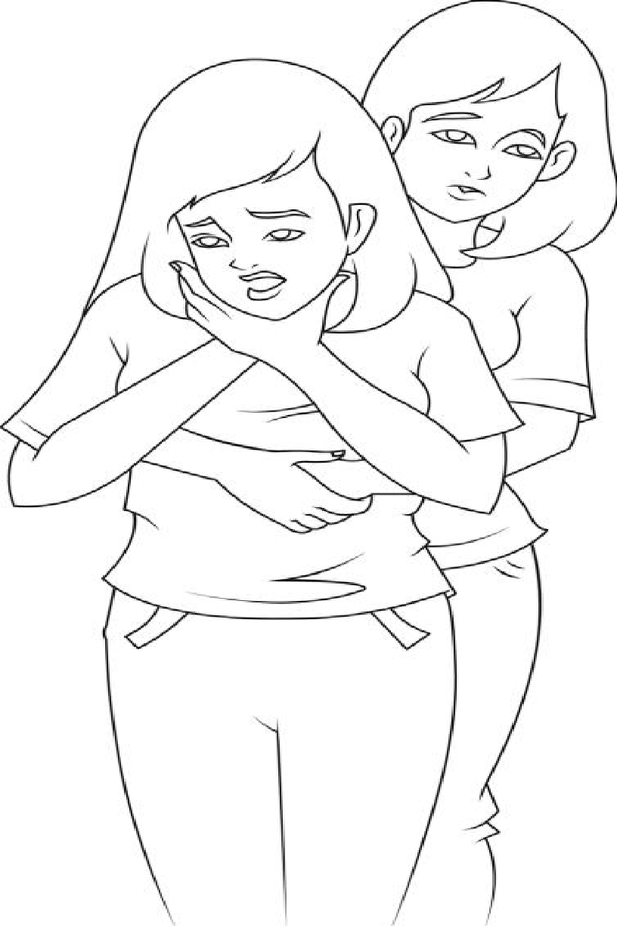
Question 5
What would you do first if you suspect someone is choking?
A) Give up to 5 back blows
B) Give up to 5 abdominal thrusts
C) Ask them if they can cough
Cough it out – can they cough?
Slap it out – up to 5 back blows
Squeeze it out – up to 5 abdominal thrusts – repeat
What if they go unconscious?
Notes:
Can they cough? If NO THEN 5 back blows, 5 abdominal thrusts, call 999 and repeat
If they go unconscious check DRABC and start CPR if they are not breathing normally

Slide 17
Question 6
How would you treat a cut to a finger?
A) Clean it, dry it & put a dressing on it
B) Give them a tissue to act as a pad and hold it in place with an elastic band
C) Apply a plaster

Slide 18
Question 6
How would you treat a cut to a finger?
A) Clean it, dry it & put a dressing on it
B) Give them a tissue to act as a pad and hold it in place with an elastic band
C) Apply a plaster

Slide 19
Question 7
What is the primary treatment for severe external bleeding to the arm?
Elevate the limb
Apply pressure to the wound
Apply a tourniquet (tie something tight at the top of the arm)

Slide 20
Question 7
What is the primary treatment for severe external bleeding to the arm?
Elevate the limb
Apply pressure to the wound
Apply a tourniquet (tie something tight at the top of the arm)

Slide 21
Question 8
How would you treat a nosebleed?
A) Pinch the nose for 10 mins, tilt the head forward
B) Pinch the nose for 10 mins, tilt the head backwards
C) Put a cold compress at the top of the nose and at the back of the neck to help the blood clot

Slide 22
Question 8
How would you treat a nosebleed?
A) Pinch the nose for 10 mins, tilt the head forward
B) Pinch the nose for 10 mins, tilt the head backwards
C) Put a cold compress at the top of the nose and at the back of the neck to help the blood clot
If still bleeding after 30 minutes, seek medical attention
Notes:
Tilt head forwards, pinch nose for 10 mins. Repeat – if over 30 mins seek medical aid.

Slide 23
Question 9
How would you deal with a wound that has glass in it?
A) Apply pressure over the top of the glass with a bandage
B) Pull the glass out, apply pressure to the wound
C) Leave the glass in and apply pressure around it

Slide 24
Question 9
How would you deal with a wound that has glass in it?
A) Apply pressure over the top of the glass with a bandage
B) Pull the glass out, apply pressure to the wound
C) Leave the glass in and apply pressure around it

Slide 25
Question 10
How do you ensure your own safety when dealing with blood and bodily fluid? Put your answers in the chat
Wear gloves
Improvise
Wash hands
Get casualty to apply pressure

Slide 26
Question 11
Name at least five things that would help you recognise a fracture?
Pain, loss of movement, angulation, swelling, tender, irregular, crepitus (grinding bones).
What are the main principles of treatment for a suspected fracture?
Keep still, support & seek medical attention (call 999 if needed)

Slide 27
Question 12
How do you treat a burn or scald?
Cool it for at least 20 mins under cold running water, cover with cling film or a clean plastic bag
Apply an ice pack or cold compress to the burn
Apply a clean dressing and then run under cold water for at least 10 mins

Slide 28
Question 12
How do you treat a burn or scald?
Cool it for at least 20 mins under cold running water, cover with cling film or a clean plastic bag
Apply an ice pack or cold compress to the burn
Apply a clean dressing and then run under cold water for at least 10 mins

Slide 29
Question 13
When should you seek medical attention for a burn?
Put your answers in the chat
Seek urgent medical help if:
The burn is deep or larger than the casualty’s hand
The burn affects the face, hands, feet, genitals or goes around a limb
The burn is caused by chemical or electricity; or they are in Shock

Slide 30
Question 14
Shock is a life-threatening condition where the circulatory system is unable to meet the demands of the vital organs to get an adequate supply of oxygen.
How do you recognise shock?
Put your answers in the chat
Pale, clammy skin; fast breathing and pulse; drowsy; feeling faint; blue lips; anxiety; dizziness; nausea.
How would you treat it?
Treat cause, lay down, raise legs, keep warm, call 999.

Slide 31
Question 15
When would you send someone with a head injury to hospital?
Put your answers in the chat
Call 999 if they are less responsive; have weakness of numbness in any part of their body; have clear fluid or blood coming from their ears or nose; suffer a seizure; or have had a serious blow to the head.
Seek medical attention if they are over 65; have had a previous brain injury; take blood thinners; have taken alcohol or drugs or there is no-one to look after them.

Slide 32
Question 16
What do these mnemonics stand for and when would you use them? Put your answers in the chat.
RICE
Rest, Ice, Comfortable Support, Elevation – Sprains and strains
CPR
Cardio Pulmonary Resuscitation – Unresponsive, not breathing
FAST
Face, Arms, Speech,Time - Stroke
AVPU
Alert, Voice, Pain, Unresponsive – Levels of Responsiveness

Slide 33
Question 17
How should you record first aid incidents?
In an accident book with tear out pages
On an accident form
In a notepad that stays in the first aid kit

Slide 34
Question 17
How should you record first aid incidents?
In an accident book with tear out pages
On an accident form (stored securely)
In a notepad that stays in the first aid kit
Records should be kept for 4 years (or 4 years after person turns 18 – if later)

Slide 35
Question 18
When do you need to notify the Scout Information Centre or Girlguiding HQ of an accident?
Only if a Leader organised professional medical treatment.
If anyone organises professional medical treatment
If it is reportable under RIDDOR (Reporting of injuries, Diseases and Dangerous Occurrences regulations)

Slide 36
Question 18
When do you need to notify the Scout Information Centre or Girlguiding HQ of an accident?
Only if a Leader organised professional medical treatment.
If anyone organises professional medical treatment
If it is reportable under RIDDOR (Reporting of injuries, Diseases and Dangerous Occurrences regulations) – this would probably have needed medical treatment as above.
Once you’ve completed the online form, HQ will notify you if further information if needed.
Notes:
The answer is B – C is partially correct but would be reportable anyway due to medical assistance having been sought.
There is an online form to be completed for HQ, who will let you know if further information is required. NB calling 111 doesn’t need a form unless you are then directed to see a medical professional.

Slide 37
Question 19
What is the non-emergency number for medical advice?
101
111
105

Slide 38
Question 19
What is the non-emergency number for medical advice?
101 – Police
111 – NHS advice line (also available at 111.nhs.uk)
105 – Power cut or emergency
Calling 111 does not need reporting to HQ unless you see a medical professional.
Notes:
111 (999 or 112 in emergency; 101 is police non-emergency; 105 is power cut/emergency line

Slide 39
Question 20
If someone in your section may have an anaphylactic reaction to nuts, what things would you have in place?
Put your answers in the chat
Young Person information form, treatment plan, briefing from parents, medication.
Risk assessments – ensure ‘nut free’ environment

Slide 40
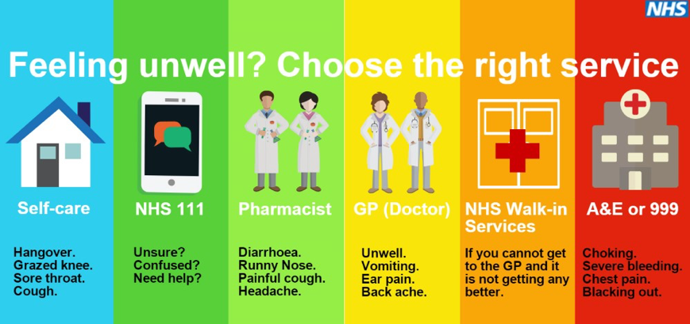
Sources of support
There are lots of places where you can get help in an emergency:
If you notice any serious unexplained illness or symptoms, you should get medical advice using 111 or 999 as appropriate.
Notes:
Remind people to seek help if they have any serious unexplained illness of symptoms

Slide 41
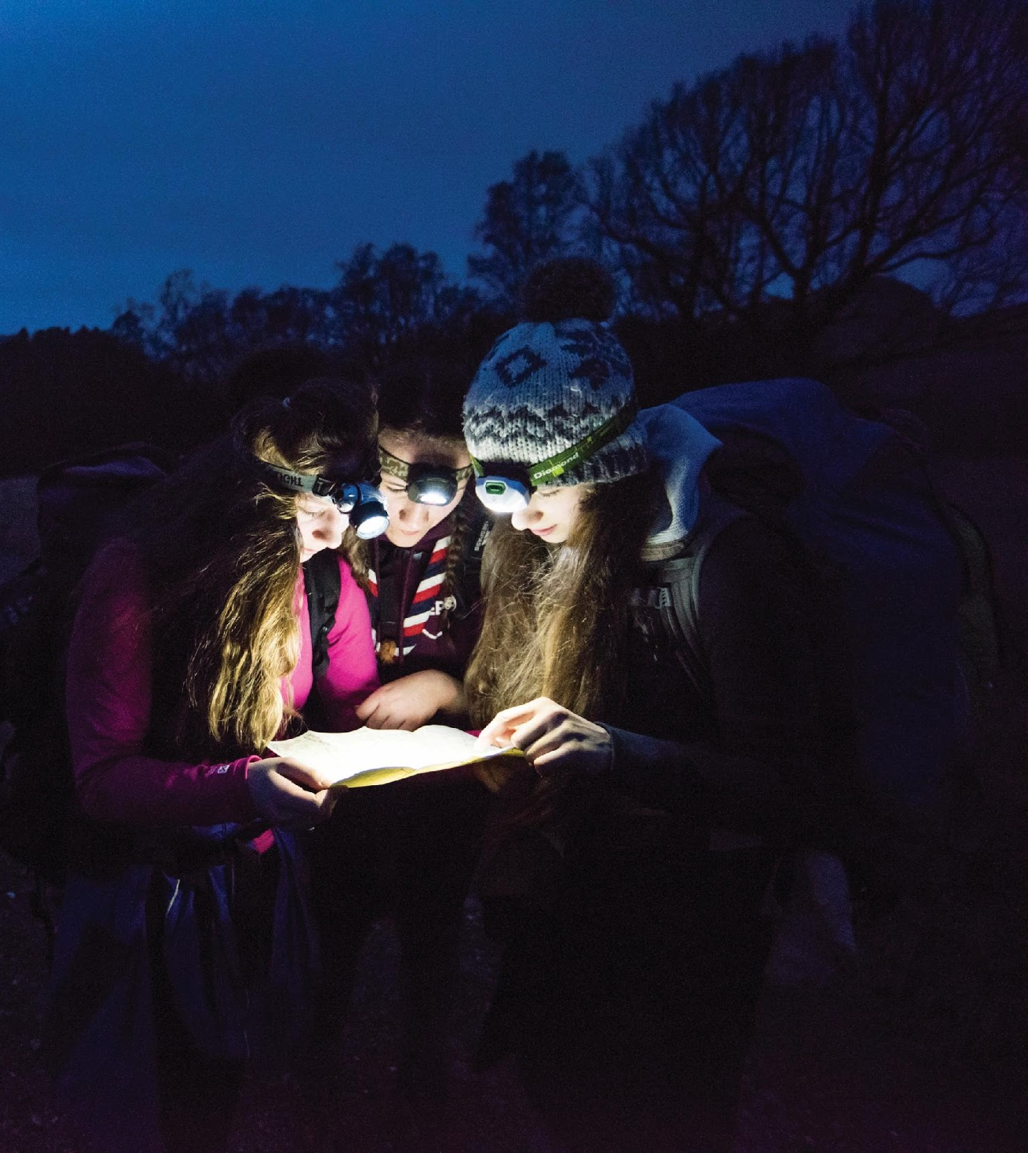
Scenario
Notes:
00:50
to
01:15
25 mins
Scenario
Split group into an even amount of break out rooms (around 6 in a group).
Odd rooms do scenario 1 & even rooms scenario 2
Read out scenarios and either ask members to take a screenshot or share the PowerPoint to the break out room.
Give groups 10 mins to discuss and then choose someone to feedback, give 2 min warning.
Go through answers, you could choose a break out room to feedback on before, during and after depending on number of rooms used.
PowerPoint slides 41-48
Zoom https://support.zoom.us/hc/en-us/articles/206476313-Managing-Breakout-Rooms
Teams https://www.youtube.com/watch?v=DMfsilBhW7A

Slide 42
Scenario in groups…
Scenario 1 (odd rooms)
You are at your HQ running a games evening for your section.
During one of the games, one of the young people falls to the floor and starts having a seizure.
They remain unresponsive for a while and are incontinent.
When the seizures finally stop they are very sleepy and confused.
Scenario 2 (even rooms)
You are leading a group of young people in the New Forest on a hike.
During the hike, one of the young people falls off a log and has a broken leg.
The event takes place in October, the weather is mild and starting to rain. There is little mobile signal where you are
What would you do:
(a) before the activities takes place?
(b) during the incident?
(c) afterwards
Please choose one person to feed back to the whole group
Notes:
Participants might want to screen shot or a facilitator screen share
Remind them to answer the three questions
Choose someone to feedback to whole group
On Zoom you can do a new ‘Screen share’ and share this slide with the breakout rooms

Slide 43
Scenario 1 – Seizure in the HQ
Before the activities take place
Staffing & ratios (1:6 Squirrels + leader in charge (min 3), Beavers, Cubs, Scouts & Explorers – 2 adults minimum)
Leader in charge
Risk assessment (recorded), including briefing leaders
First aid kit available
InTouch
Records of young people’s medical conditions available on site
Notes:
Squirrels indoor 1:6 + leader in charge - minimum 3 leaders
Beavers to Explorers indoor – minimum 2 adults

Slide 44
Scenario 1 – Seizure in the HQ
During the activity
Make space around the person, one leader to take other members away from incident & reassure.
Use PPE to clean up any incontinence
Remove any dangers around the person & protect their head
Note the time it starts & time if possible
When seizure finishes, place in recovery position
Call parents or next of kin
Call 999 if:
    Repeated seizures
    Seizure continues for longer than 5 minutes
    Patient is unresponsive for longer than 10 minutes
    First seizure

Slide 45
Scenario 1 – Seizure in the HQ
After the incident
Debrief with team and young people
Inform Line manager
Complete local accident report
Inform Scout Information Centre or complete accident form online if medical help sought during or afterwards
Review risk assessment

Slide 46
Scenario 2 - Hike in the New Forest
Before the activities take place
Staffing & ratios (Squirrels 1:4 + leader in charge – min 3 adults, Beavers 1:6 + LIC, Cubs 1:8 + LIC, Scouts 1:12, Explorers – min 2 adults)
Leader in charge
Risk assessment (recorded), including briefing leaders
Check Terrain Zero guidance / POR / Notify line manager
First aid kit / equipment / kit check e.g. waterproofs and access to someone holding first response certificate (for hikes this could be training given to group members)
InTouch
Route plan left with responsible person
Notes:
Squirrels outdoor 1:4 + leader in charge - minimum 3 leaders
Beavers outdoor 1:6 + leader in charge
Cubs outdoor 1:8 + leader in charge
Scouts outdoor 1:12
Explorers outdoor minimum 2 adults
In the case of groups hiking remotely they need to have appropriate first aid training plus access to a leader holding first response. For adventurous activities this must be immediate access to a first response holder (or 16 hour course if identified in risk assessment or more than 3 hours from help).

Slide 47
Scenario 2 - Hike in the New Forest
During the activity
Suspected fracture – keep still, do not move, support with soft padding.
Reassure, ask for pain score out of 10 (write down, with time)
Rain/wet conditions – waterproofs, shelter needed?
Ensure all group are keeping warm and dry if possible
Use OS locate or What3Words to get location of incident & write it down
Mobile signal – go uphill to get signal, try texting 999*, send two people to get help at place of habitation
Inform parents when on way to hospital
* To use emergency SMS send ‘register’ to 999 to register your phone More information at www.emergencysms.net

Slide 48
Scenario 1 - Hike in the New Forest
After the incident
Debrief with team and young people
Inform Line manager
Complete local accident report
Inform Scout Information Centre or complete accident form online if medical help sought during or afterwards
Review risk assessment

Slide 49

Notes:
01:15
to
01:25
10 mins
Break (10 mins)

Slide 50
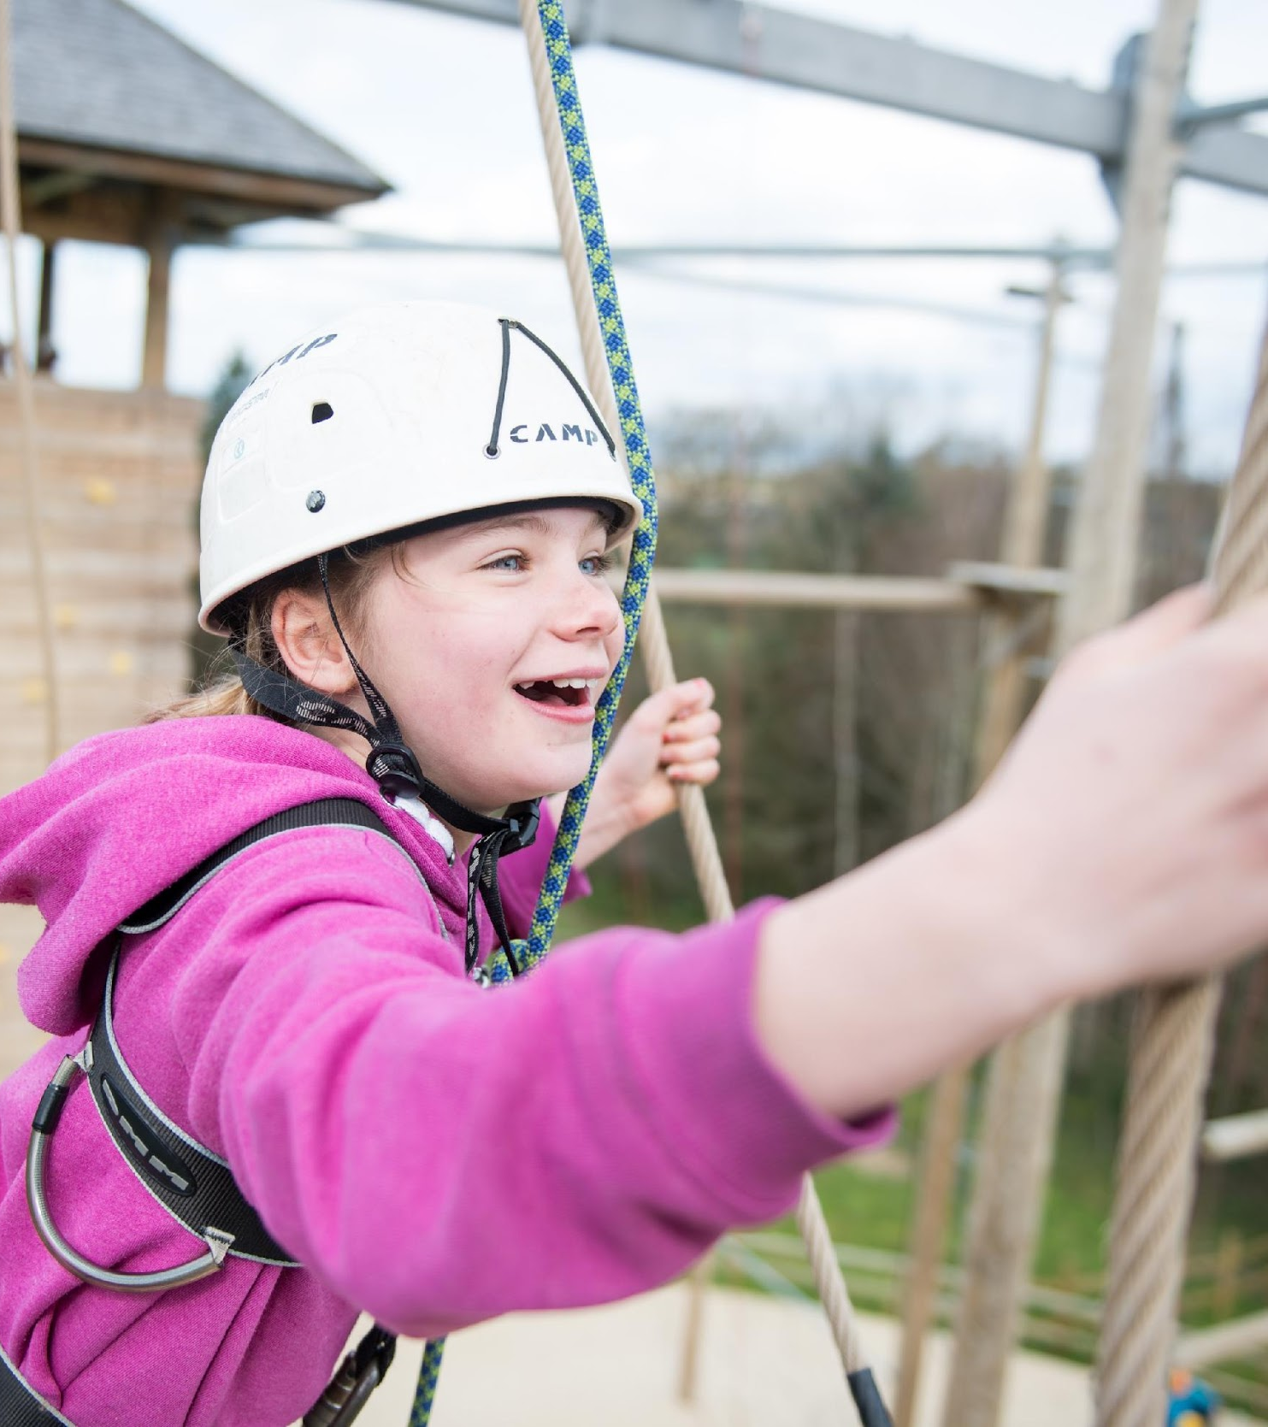
Walking debate – true or false
Notes:
01:25
to
01:50
25 mins
Walking debate
Explain that this activity is to promote discussion and there is a continuum of answers.
Ask each question and get responses via the poll; get people to explain why they have chosen their answer (true/false/middle)
PowerPoint slide 50-59

Slide 51
Walking debate on Zoom!
Aim: to discuss various First Aid principles and discuss correct treatment. The statements are designed to provoke discussion!
Please answer TRUE or FALSE although there are middling options as it is a continuum

Slide 52
      1.
      If someone is feeling faint you should sit them down and put their head between their legs?
True
False
Notes:
F – they might faint and hit your head.You should lay them down and raise their legs.

Slide 53
      2.
      When someone has broken legs, we should not raise them if they are in shock?
True
False
Notes:
F – this could make the injury and therefore the bleeding worse.

Slide 54
      3.
      You can give aspirin to young people as pain relief?
True
False
Notes:
F – aspirin must only be given to people 16+. When is it used? - generally used for a heart attack (one 300mg dose to chew).

Slide 55
      4.
      We should remove clothing if someone is burnt?
      Both
True
False
Notes:
T & F – we would generally remove clothing, unless it is stuck to the skin.

Slide 56
      5.
      People with arm fractures should always have a sling?
True
False
Notes:
F – we can offer a sling if the casualty will let you, otherwise use padding and let casualty support

Slide 57
      6.
      Sprains – you should not remove the boot if someone is on a hike?
True
False
Notes:
F – generally leave in place and loosen boot so you can get them to a road using walking pole/support.What is the treatment for sprains? RICE – Rest Ice Compression/Comfortable support Elevation

Slide 58
      7.
      Meningitis – the rash disappears when you press a glass onto it?
      The rash is a late sign, what other signs & symptoms are there?
True
False
Notes:
F – the purpuric rash does not disappear under a glass - although the rash is a late symptom.What other signs and symptoms are there? Includes: drowsy, fever, muscle pains, headache, dislike of light, stiff neck, seizures and cold limbs.

Slide 59
      8.
      If a child does not have their inhaler, they can use one belonging to someone else?
True
False
Notes:
F – they are prescribed to a specific person and are different drugs & doses. What should be in place? We need to ensure we have information about the plan to follow, ensure they have their inhaler and a spare on camp. Sometimes they will also have a spacer to help take their inhaler. Call 999 if you need further advice.

Slide 60
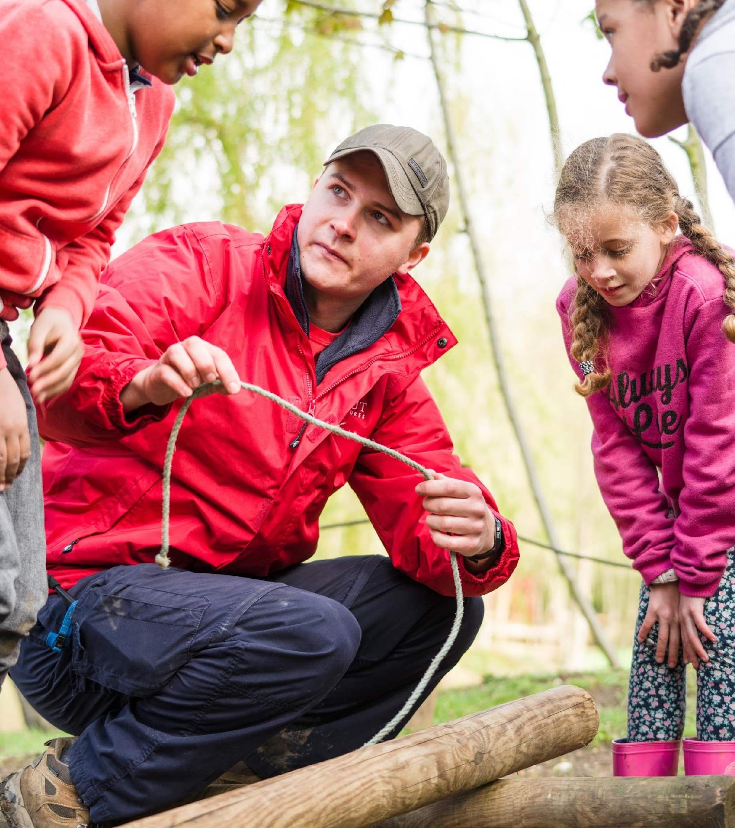
Medical Conditions – key points in groups
Notes:
01:50
to
02:20
20 mins
Medical conditions
Split into five break out rooms, giving each a scenario (either ask them to screen shot or share the PowerPoint to the breakout room)
Get them to discuss (5 mins) key points on the treatment and feedback (15 mins). They can also note down any questions they have as a group.
Heart attack
Stroke
Diabetes
Anaphylaxis
Asthma
PowerPoint slides 60-62

Slide 61
Medical conditions
In groups you have one minute to recall the key treatment and any questions you want answered
1) Heart attack – a leader has chest pain, radiating down the left arm. They are sweating, feel sick and dizzy.
2) Stroke – a leader has collapsed – you do FAST test and their face is drooping, speech is slurred and they cannot move one side of their body.
3) Diabetes – a young person you know has the condition is pale, cold, sweaty and breathing rapidly – they have missed their lunch.
4) Anaphylaxis – a young person is stung by a bee and has blotches on their face and is beginning to get breathless, feeling weak and dizzy.
5) Asthma a young person you know has the condition forgot to take their inhaler before playing a game – they are distressed, wheezing and have difficulty breathing.
Notes:
Use break out rooms to discuss and feedback

Slide 62
Medical conditions
Heart attack
Stroke
Diabetes
Anaphylaxis
Asthma
Call 999, sit down, offer aspirin (300 mg – chew).
FAST – Face, Arms, Speech, Time.
Give sugar (e.g. sweet drink, jelly babies, glucose tablets); call 999 if does not improve.
Call 999 (mention “anaphylaxis”), administer adrenaline pen (and second pen if needed).
Sit them down, help with inhaler / spacer, up to 10 times, call 999 if does not improve.
Notes:
Run through answers & add any additional information
Might be useful to demonstrate auto injector if available

Slide 63
Extremes of Temperature
Please note this section is in addition to the First Response syllabus
Notes:
02:20
to
02:30
10 mins
Extremes of Temperature
Explain that a symptom will appear on the screen and they need to identify if it is heat exhaustion, hypothermia or both.
You could use the chat to ask people to respond - H = hot, C = cold and B = both or you could use a poll
Run through the treatment for Heat exhaustion and Hypothermia - you could use the chat for suggestions
This is additional to the first response syllabus so can be omitted if time does not allow.
PowerPoint slides - 63-65

Slide 64
Extremes of Temperature
Has a temperature below
35 degrees Celsius
Can develop gradually
Cold to the touch
Breathing more slowly
Shivering
Feeling sick
Headache
Confusion
Sweaty
Pale skin
Heat exhaustion | Both | Hypothermia
Notes:
The Symptom moves to the appropriate column on each click
You might use the chat and ask people to respond H – Hot B – Both C – Cold
You could also use a poll if you want to

Slide 65
Extremes of Temperature - treatment
Heat exhaustion
Hypothermia
Move the person to a cool place
Remove any excess clothing
Lie down and raise feet if feeling faint
Drink sports or rehydration drink, or cool water
Cool their skin by applying cool water or fan them (cold packs under arm pits or back of neck can also help)
Call 999 as soon as possible
Move then indoors or to shelter
Remove wet clothing
Apply layers of clothing or blankets / sleeping bag, covering head
Give them warm drinks and energy food if they are awake
No alcohol or direct heat

Slide 66
Quick fire minor conditions
Please note this section is in addition to the First Response syllabus
Notes:
02:30
to
02:40
10 mins
Minor Injuries
Run through the list of minor conditions discussing the treatment for each - use notes for guidance
This is additional to the first response syllabus so can be omitted if time does not allow.
PowerPoint slides - 66-67

Slide 67
What would you do?
Animal / Snake bite
Tick Bite
Dehydration
Earache
Bee sting
Splinters
7. Eye injury
8. Blister
9. Graze
10. Stomach ache
11. Bruise
12. Sunburn
Notes:
Minor Conditions
Animal bite: clean, pressure, dressing; risks (e.g. tetanus) – seek medical advice
Snake bite: keep still, treat bleeding, seek medical advice
Dehydration: fluids; if tired, confused or dizzy get medical advice
Tick bite: remove with tick remover or tweezer; wash – if you get flu-like symptoms e.g. fever, headache, joint pains or a red ring around tick this could be Lyme’s disease – seek medical advice
Earache: paracetamol warm compress – if unsure seek medical advice
Bee sting: scrape with card, do not squeeze, cold compress
Splinter: Clean and remove if possible. Cover with plaster
Eye injury: flush out any particles, do not rub, cover and seek medical advice
Blister: do not burst but allow fluid to drain, cover with blister plaster / dressing
Graze: wash, dry, dress
Stomach ache: why? – e.g. indigestion, constipation. If severe, seek medical advice
Bruise: cold compress. Consider cause
Sunburn: cold water / after sun / calamine – seek medical advice if severe

Slide 68

Any questions?
Notes:
02:40
to
02:45
5 mins
Finish and next steps
Thank people for taking part
Ask if there are any questions
Take register (if not done so at beginning)
Remind people of next steps to complete 10B
Post course
Issue certificate
Update 10A on Compass
PowerPoint slides - 68-70

Slide 69
Next steps
Completion of first response
Module 10A – First Aid Theory is now complete – we will issue you with a certificate and/or update the membership system. Note your expiry date 3 years from today!
Module 10B – First Aid Practical (15 min session) needs completing.
This includes: Know and demonstrate (or instruct a trainer) your skill in performing
  Approach and assessment of scene/incident
  CPR for an adult
  CPR for a child
Notes:
Reminder of next steps
Run through module 10A/B and add any local information on where to access local training dates

Slide 70
Module 10A/K First Response
Thank you for taking part
Notes:
2:30 – close
Thanks people for attending

